Slide 1
Simultaneous Intracranial Artery Tracing And Segmentation From Magnetic Resonance Angiography By Joint Optimization From Multiplanar Reformation
Li Chen¹, Gaoang Wang¹, Niranjan Balu¹, Mahmud Mossa-Basha¹, Xihai Zhao², Rui Li², Le He², Thomas S. Hatsukami¹, Jenq-Neng Hwang¹, and ChunYuan^{1*}
¹ University of Washington, Seattle, WA, USA
² Tsinghua University, Beijing, China

Slide 2
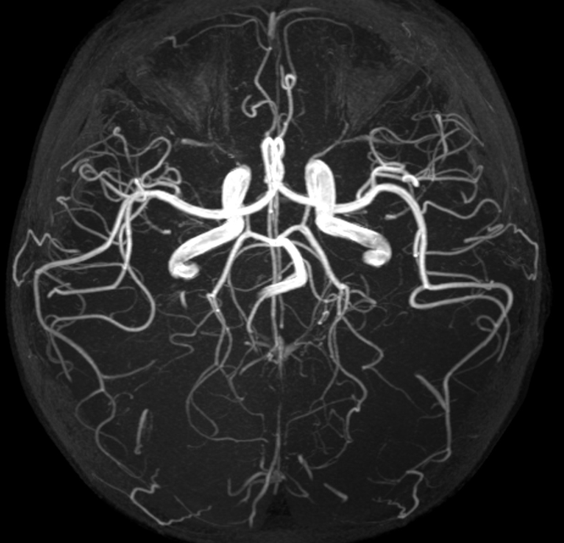
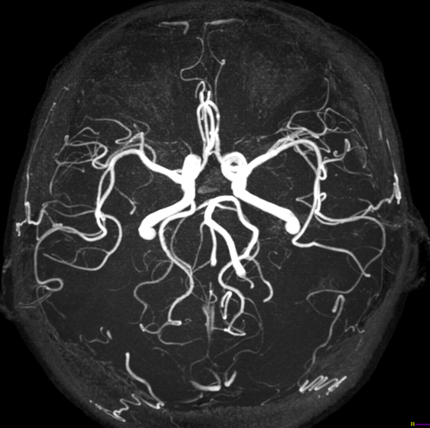
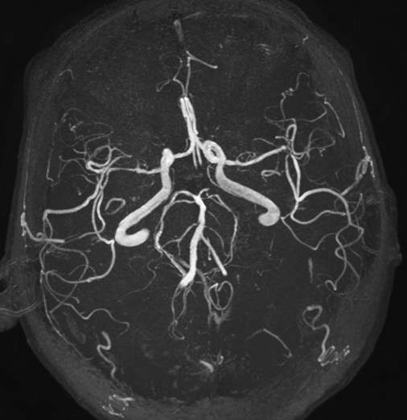
Background: intracranial vasculature quantification
Intracranial artery structure and intensity may reflect cerebral blood flow
10Y
52Y
67Y
Vascular structure and signal differences observed from Maximum Intensity Projection (MIP) view of 10/52/67-year-old subject from 3D TOF MRA
Images from CBIR, Tsinghua University

Slide 3
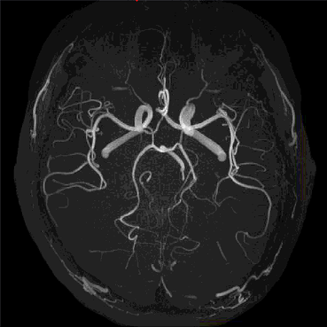
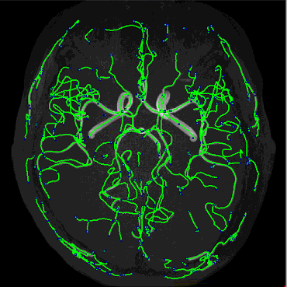
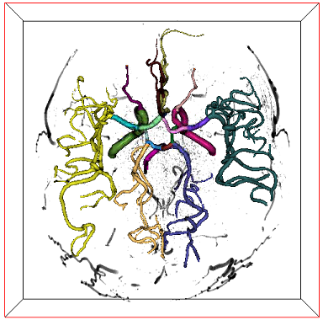
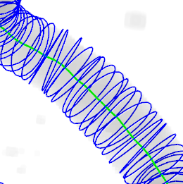
Intracranial artery quantification
iCafe (intraCranial artery feature extraction) [1] to generate artery centerlines for quantification from Magnetic Resonance Angiography (MRA)
  Represent arteries as a network of centerlines with varying radius
  Manual operations (correct mistakes in traces) could take hours to ensure best qualities
Quantification
Tracing
3D MRA image
Artery centerlines and 3D rendered results
Feature calculation
[1] L. Chen, et. al, Magn Reson Med, 2018

Slide 4
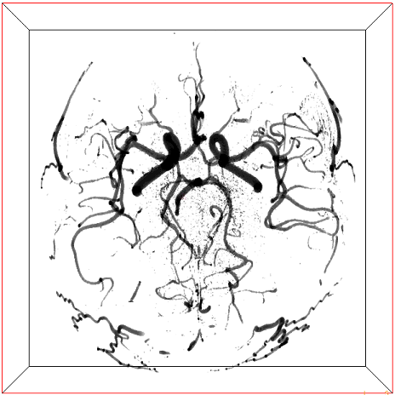
Alternative approach for centerline generation
Generating centerlines from segmentation
  Fill pixels inside iCafe generated traces as labels to train an artery segmentation model [1]
  Tracing from segmentation, which has better contrasts for weak distal branches
  Traditional skeletonization methods might not preserve artery structures, new methods needed
Segmentation
Tracing from segmentation
Training label
Tracing
3D MRA image
Artery traces and 3D rendered results
Segmentation results
[1] L. Chen, et. al, IEEE BIBM, 2017

Slide 5
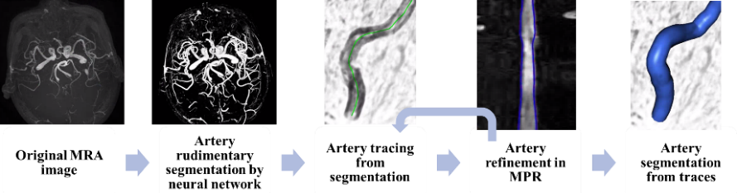
Workflow of the proposed method
Tracing from segmentation to take advantage of better artery contrasts
Refinement during tracing to allow robust centerline generation
Segmentation from tracing to refine segmentation results

Slide 6
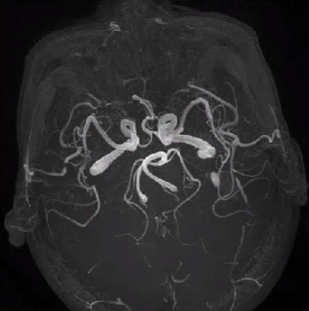
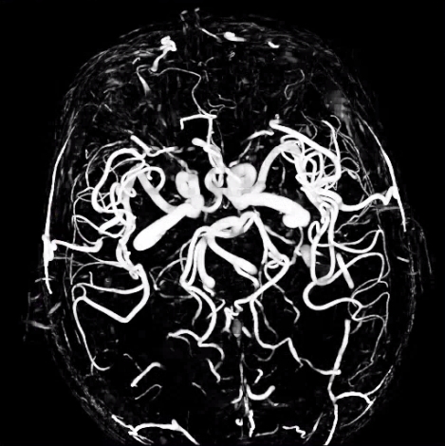
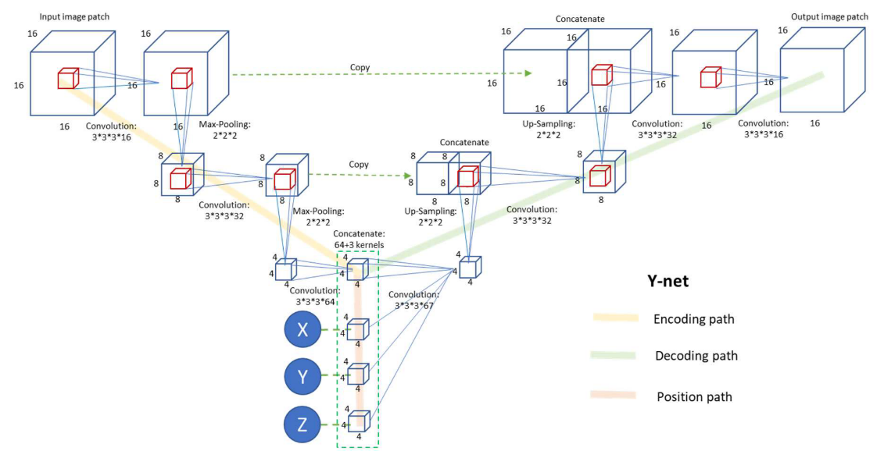
Rudimentary segmentation by neural network
3D TOF MRA resliced in isotropic resolution
Nyul [1] intensity normalization for comparable intensity among subjects
Segmentation model trained from manually corrected iCafe traces of 163 subjects [2]
  Y-net [3]: 3D U net model with location as an additional input
Centers of each 3D connected region in the segmentation image are considered as seed points to initiate tracing one at a time
[1] L. G. Nyul, IEEE Trans. Med. Imaging, 2000
[2] L. Chen, et. al, Neurobiol. Aging, 2019
[3] L. Chen, et. al, IEEE BIBM, 2017
Original Image
Y-net
Segmentation

Slide 7
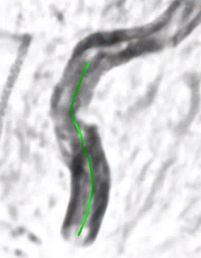

Artery tracing from segmentation - Matching
Iteratively tracing by finding the best matching cross-sectional planes
  Search in the half sphere towards the stretching direction, 30 degrees increments
  Choose the direction with maximum score calculated by three metrics
Score calculated from three metrics
  Circular similarity (CS): the Dice similarity coefficient (DSC) of the segmented region in cross-sectional plane with a perfect circle with the same area
  Neighboring similarity (NS): DSC of segmented region in neighboring planes
  Signal change rate (SCR): the relative signal difference in the center pixels of the original image
  Total score is 0.8 CS + 0.2 NS – SCR
  Match the plane if total score over a threshold
Cross-sectional plane of a certain point
30 degrees
37 possible directions for stretching (30 degrees apart in each axis)

Slide 8
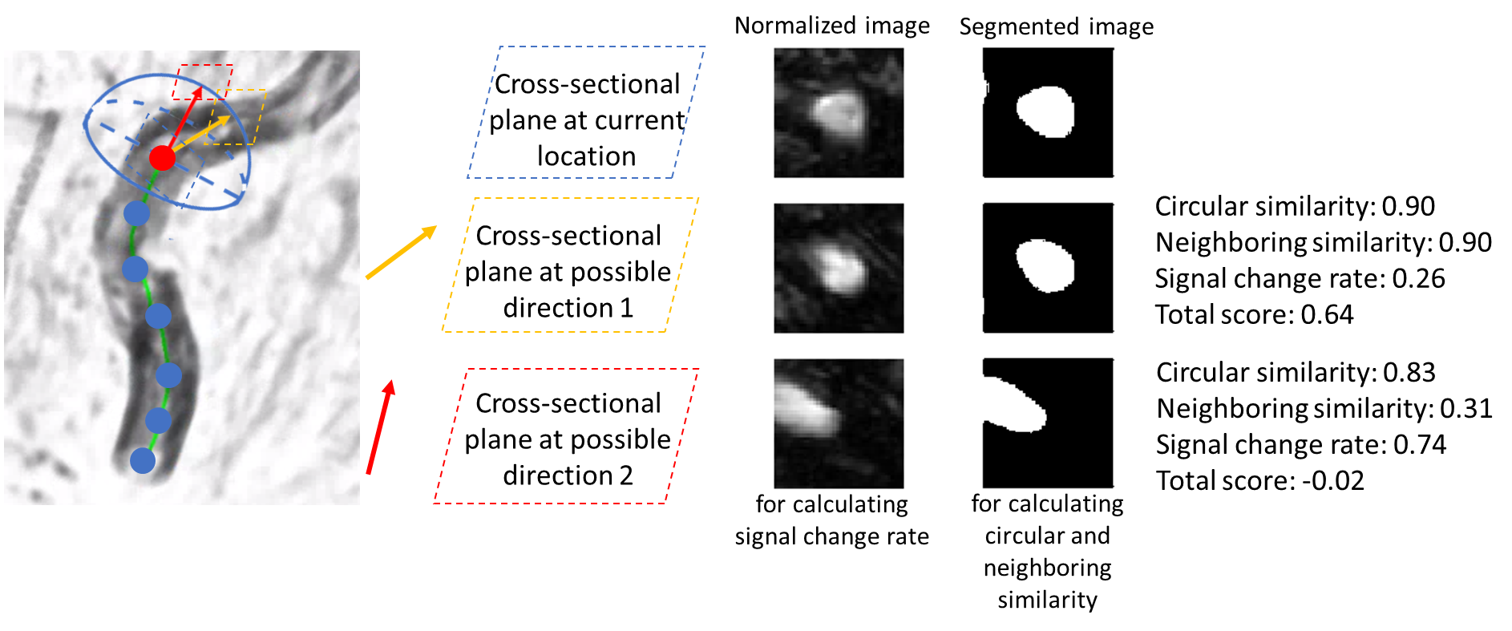
Artery tracing from segmentation - Matching example
The yellow plane has higher score, choose that direction as the stretching direction in this iteration

Slide 9
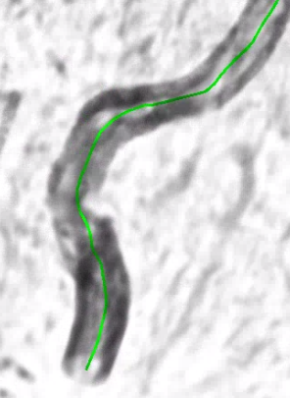
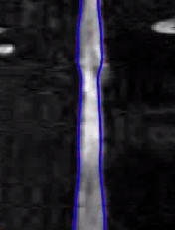
Artery tracing from segmentation - Trace refinement
Near neighboring matching does not incorporate global information
  Might have centerline deviation
  Might have abrupt radius change along the centerline
Refinements in Multi-Planar Reformation (MPR) view will be helpful
  Horizontal: profile along a selected angle, vertical: along artery centerline
  MPR can be generated at multiple angles using profiles of different degrees
  Ideally artery should be straightened in the center of MPR in all angles
Profile of 90 degree
MPR
Profile of 0 degree
Cross-sectional plane of a certain point
MPR with profiles of 0 degree with radius boundaries
Original trace

Slide 10
Artery tracing from segmentation - Trace refinement
Three components for refinements
  Trace position refinement: optimization algorithm minimizing the loss for trace smoothness and image intensity
  Trace radius refinement: optimization algorithm minimizing the loss for radius boundary location smoothness and gradient of intensity at the boundary
  Trace deviation correction: dragging back the points leading to deviated boundary in MPR
Procedure of refinement
  Cross-sectional plane matching for 25 iterations
  Refinement in each of the 0,90,45,135 degree angles
  Repeat refinements for 3 times
  Continue matching until end of tracing

Slide 11
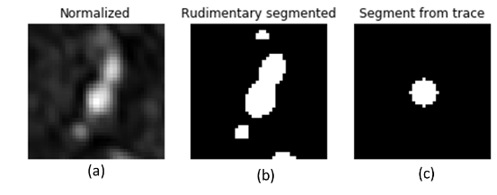
Segmentation from tracing
Fill the regions inside the traced tubes (centerline with radius) to be the refined segmentation results
Segmentation in cross-sectional planes are circles, more editing if detailed analysis is needed
Improved segmentation from tracing when two arteries are close. Cross-sectional slice for normalized image (a), rudimentary segmentation (b) and improved segmentation (c)

Slide 12
Dataset for evaluation
Four subjects from a healthy community study [1] and four subjects from a group of patients with intracranial atherosclerosis [2]
The data collections followed local institutional review board guidelines.
3D TOF imaging parameters
  Scanned on 3.0T MR scanners
  Repetition time/echo time = 25/3.5 ms
  Flip angle = 20°
  In-plane resolution = 0.35 mm×0.35 mm
  Slice thickness = 1.4 mm
[1] L. Jiang, et. al, J. Magn. Reson. Imaging, 2015
[2] M. Mossa-Basha, Br. J. Radiol, 2019

Slide 13
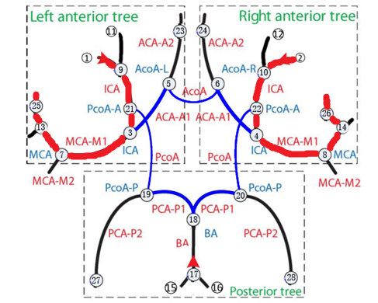
Manual labeling as ground truth
Only two major clinically important arteries (from the distal internal carotid artery, M1 segment of middle cerebral artery, until the most distally clearly visualized segment) per case are evaluated
Labels generated from iCafe tracing with careful manual corrections of centerline position and radius
Intracranial artery map
Red arteries are the arterial segments evaluated in this study

Slide 14
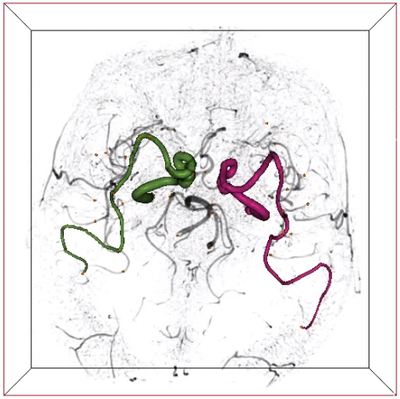

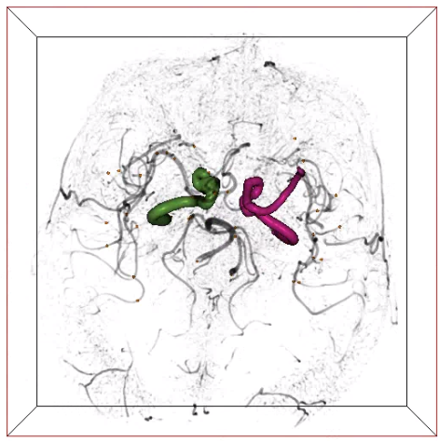
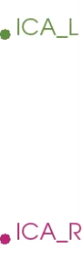
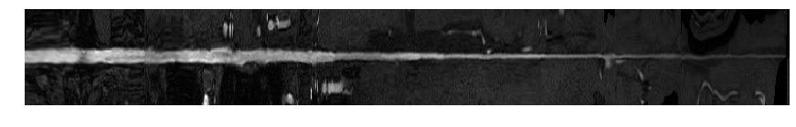
3D visualization of tracing results from a healthy subject
MPR
Proposed tracing method
Ground truth
Tracing without refinement
(Rough shape and earlier termination)

Slide 15
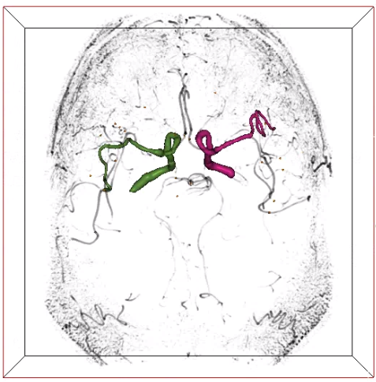
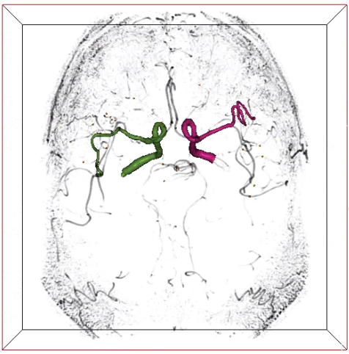
3D visualization of tracing results from a diseased subject
Tracing results from proposed method
Tracing results from ground truth

Slide 16
Quantitative comparison with ground truth
Methods | Subject groups | Mean absolute length difference | Mean volume DSC | Mean absolute tortuosity difference
Tracing with refinement | Healthy group | 1.86% | 0.85 | 2.75%
 | Disease group | 3.64% | 0.80 | 2.94%
Tracing without refinement | Healthy group | 40.72% | 0.53 | 20.94%
 | Disease group | 16.87% | 0.55 | 15.16%

Slide 17
Validation on continuity of tracing
How many seeds needed for tracing the whole artery
Compare with traditional method: open-curve active contour algorithm [1] in iCafe
Traditional method needs an average of 4.9 manually given seeds
The proposed method only needs one to trace the whole artery segment
[1] Wang Y, Proc IEEE Comput Soc Conf Comput Vis Pattern Recognit, 2011

Slide 18
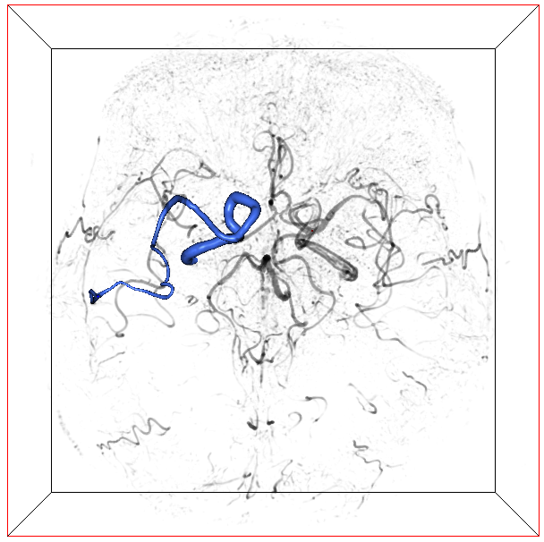
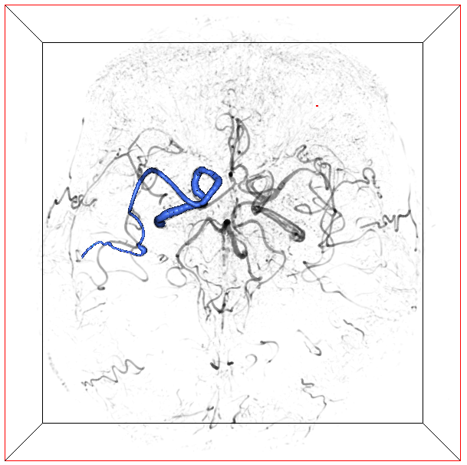
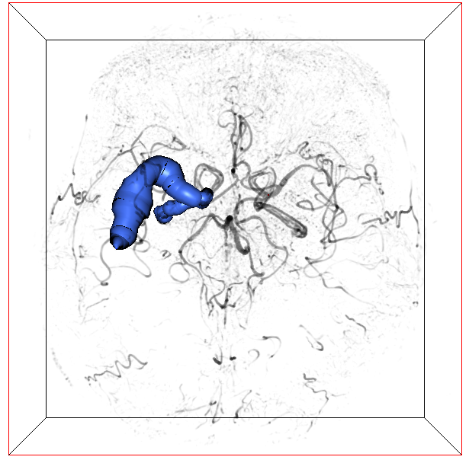
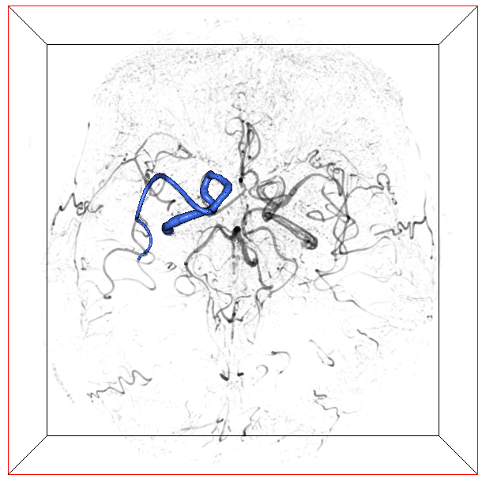
Comparison with other tracing methods
Left side arteries from four healthy subjects compared with methods in VMTK [1]
All three comparison methods
  Suffer from weak signals in distal arteries, so that the tracing is stopped earlier
  Fail for the diseased group
(a) Proposed
(b) Colliding fronts
(c) Fast marching
(d) Iso-surface
[1] www.vmtk.org

Slide 19
Quantitative comparison with tracing methods
Three metrics used for comparison
  Mean absolute length difference: lower better
  Mean volume DSC: higher better
  Mean absolute tortuosity difference: lower better
Methods | Mean absolute length difference | Mean volume DSC | Mean absolute tortuosity difference
Our method | 2.33% | 0.86 | 2.36%
Colliding fronts | 14.27% | 0.69 | 7.91%
Fast marching | 33.55% | 0.43 | 10.32%
Iso-surface | 27.28% | 0.73 | 11.62%

Slide 20
Limitations
A small sample size (N=8) is used for validation
A selected set of major arteries from each subject are assessed
Cross-sectional matching is empirically designed, machine learning approaches can be attempted
Segmented regions are still represented as tubes, which may not reflect real shape of diseased arteries

Slide 21
Conclusions
A simultaneous artery tracing and segmentation method is proposed
Use segmentation results to help better tracing (better contrast)
Use tracing results to help better segmentation (separate close arteries)
Take advantage of cross-sectional plane relations and MPR to match and refine traces for better robustness and accuracy

Slide 22
Acknowledgement
We acknowledge the contributions from our collaborators.
We gratefully acknowledge the support of NVIDIA Corporation for donating the Titan GPU.
Please contact lab co-director Dr. Chun Yuan (cyuan@uw.edu) or Li Chen (cluw@uw.edu) for more questions or collaborations.

Slide 23
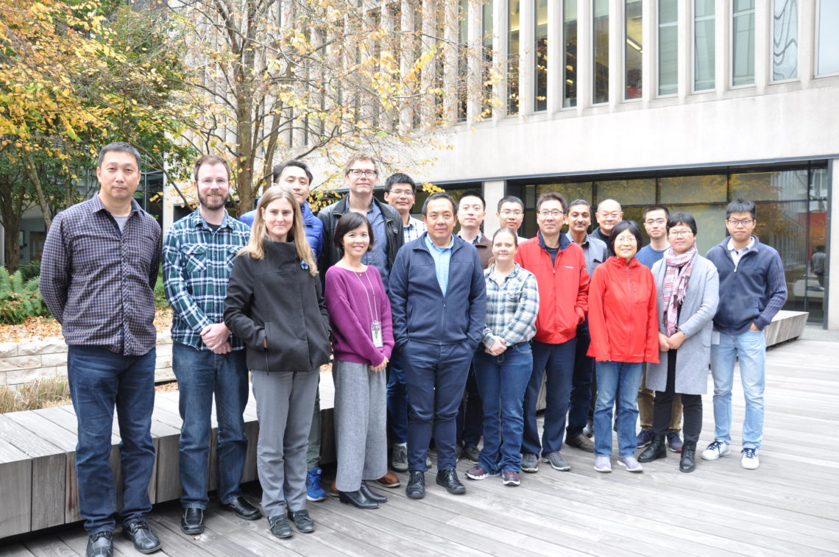
Thanks for your attention!
Vascular Imaging Lab
University of Washington

