Slide 1
An Adaptive Computer-aided Tongue Diagnosis Method using Color-calibration Preprocessing and Multiple Feature Synthesis based on Android Platform

Slide 2
Background
According to Traditional Chinese Medicine (TCM), the tongue can reflect the condition of organs as well as the degree and progression of disease.
The prevalence and capability of mobile phones offer an ideal platform for our tongue diagnosis system to be practiced.

Slide 3
Problem
In traditional method of tongue diagnosis, doctors determine the syndrome mainly through visual observation and subjective experience.
Quite a few computerized tongue diagnosis methods are quite sensitive to the quality of the initial tongue image. Camera bears the possibility of distorting the original colors of the images

Slide 4
What we do
An Android APP:
Use QCGP to solve the problem of white balance
Adapted HSV model in Tongue brim pixels searching
Adapted inverted pentagonal four-line tongue outline searching and linking algorithm
Accuracy and effectiveness corroborated with professional clinicians

Slide 5
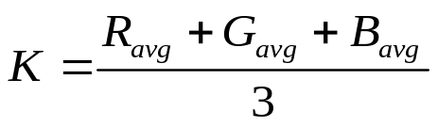
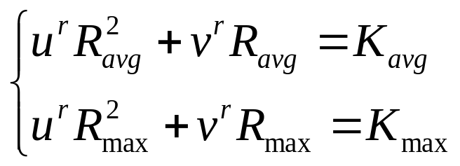
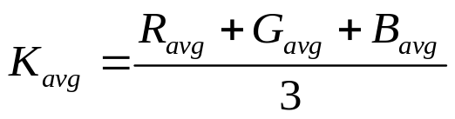
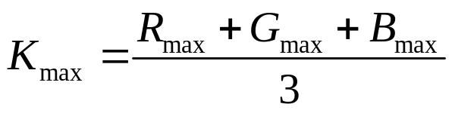
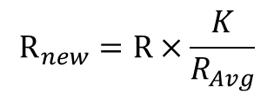
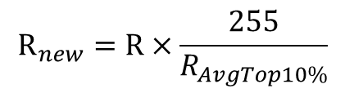
QCGP(Quadratic Combining GW&PR)
$$R_{new}=R×\frac{K}{R_{Avg}}$$
a) Grey World Method
assuming a certain standard spatial spectral average exists
b) Perfect Reflector Method
most reflective spot can be used to scale RGB values of other area
c) Quadratic combining two balance algorithms
$$R_{new}=R×\frac{255}{R_{AvgTop10\%}}$$

Slide 6
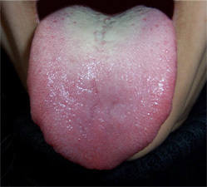
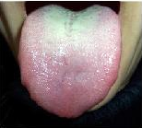
White Balance
Initial tongue image
Tongue image after color calibration

Slide 7
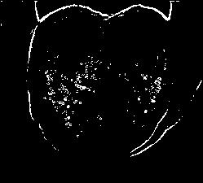
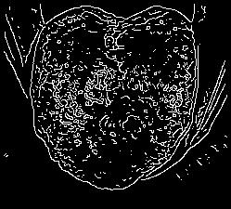
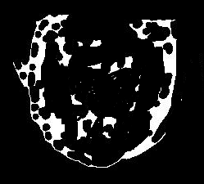

Main procedure
Tongue brim edges
Tongue edges image
General tongue brim image
Tongue outline image

Slide 8
Tongue feature extraction
Parameters:
thickness of tongue coating: the ratio of the number of tongue coating pixels(a hue range near yellow) to that of total pixels
average hue of tongue blade pixels: average hue within a hue range near red and also not excessively big in value
humidity of the tongue: the ratio of pixels with excessively big values to that of total pixels
crackle flaws: the ratio of edges pixels in edge image to that of total pixels

Slide 9
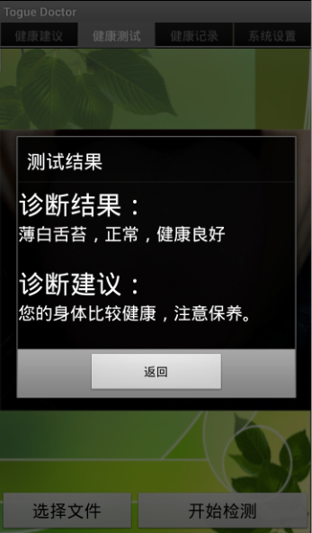
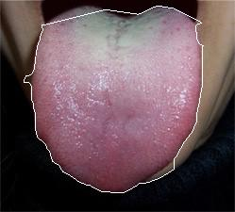
Test Result
Tongue area within white outline
Feature | Value
thickness | 0.1684
Crack | 0.0584
Humidity | 0.0976
Classification and diagnosis
Tongue is in light red with thin white coating which is normal and healthy. The clinical features suggest that the patient is in good health and more care is needed to maintain the present physical condition.
Statistics of the main feature of the tongue image

Slide 10
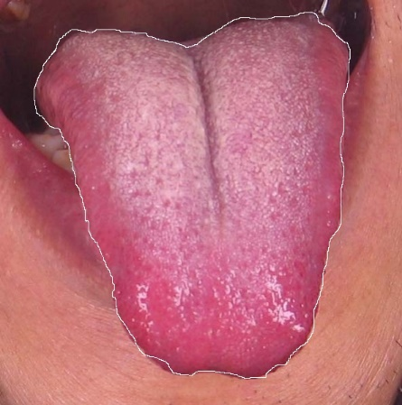
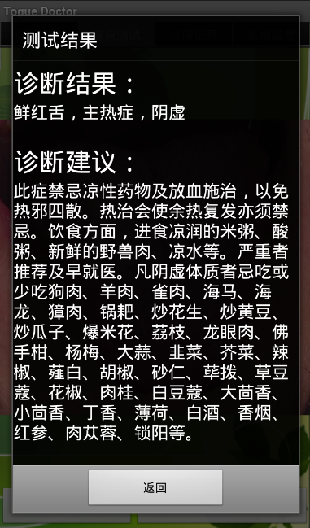
Some unhealthy cases
Diagnosis:
Pale tongue, deficiency of vital energy and blood
Recommendation:
Slow in motion, maintain your energy and life routines, keep good hours. Besides eating more warming foods, such as beef, mutton, shrimp, loach, eel etc., the clients can use Fu Yang tank to dredge the acupuncture points in needle warming moxibustion, involving energy pass, vital points, kidney shu, to relieve symptoms.

Slide 11
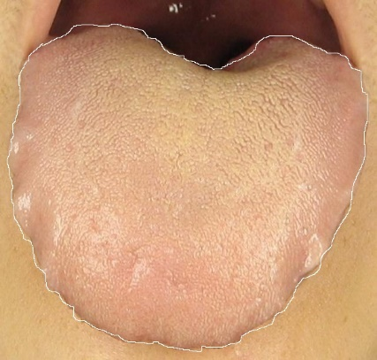
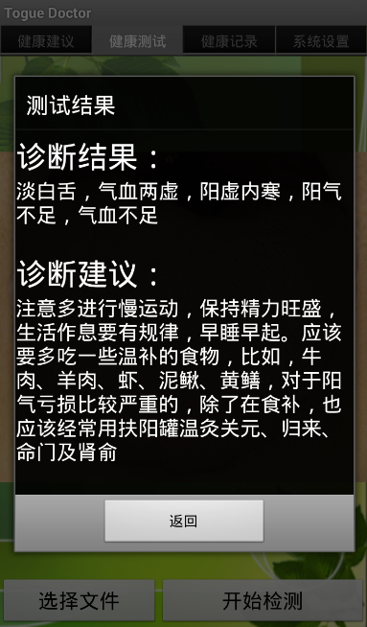
Some unhealthy cases
Diagnosis:
Fresh red tongue with fever and irritability
Recommendation:
Abstaining from cold medicine, bloodletting treats and pathogenic heat scatters, clients should also avoid warming treats which generate afterheat recidivation. Besides not having hot rice or acidic gruel, cool water, fresh vension, you’d better seek medical advice. Aimed clients are recommended not to inhibit the consumption of dog meat, mutton, sparrow, sea horse, sea otter, rice crust, fried peanuts, fried beans, fried melon seeds, popcorn, litchi, longan, bergamot, waxberry, garlic, leek, shepherd's purse, Chillies, pepper, Fructus Amomi, Alpinia katsumadai, cinnamon, Cardamom, anise, fennel, clove, mint, distilled spirit, cigarette, red ginseng, cynomorium songaricum etc.

