Slide 1
The Application Characteristics of Traditional Chinese Medical Science Treatment on Vertigo Based on Data Mining Apriori Algorithm

Slide 2
Background
mechanism of the effective traditional Chinese medical treatment remains ambiguous
researchers are seeking to analyze the therapies using traditional Chinese medicine (TCM) with advanced techniques
Data mining is widely applied in various fields

Slide 3
What we do
we apply Apriori algorithm to the analysis of a series of medical records on vertigo from famous TCM doctors
syndromes
Chinese herbs
symptoms

Slide 4
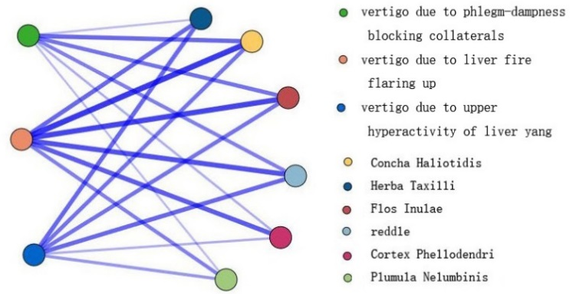
One result
Association rules between TCM syndromes and Chinese herbs
Confidence (%) | Rule Support (%)/ Support (%) | Lift（conf/conse%） | Rules
88.889 | 22.857/25.714 | 1.004 | PBC→Concha Haliotidis
83.333 | 21.429/25.714 | 0.956 | PBC→Flos Inulae
88.889 | 22.857/25.714 | 1.037 | UHL→reddle
88.889 | 22.857/25.714 | 1.27 | UHL→Herba Taxilli
80.952 | 24.286/30 | 1.232 | LFF→Cortex Phellodendri
66.667 | 20/30 | 1.085 | LFF→Plumula Nelumbinis

Slide 5
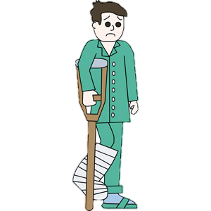
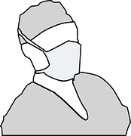


Application circumstance
Server database
Mobile app
Mobile app
doctor
Patient or New doctor

Slide 6
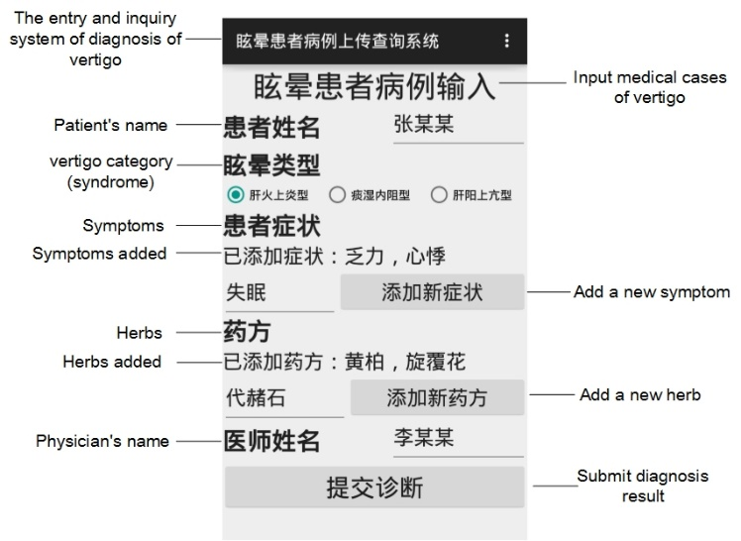
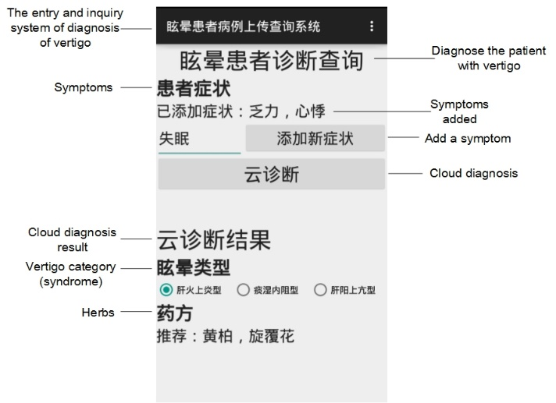
App
For doctor
For patient

