Slide 1
A Novel Automatic Tongue Image Segmentation Algorithm:
Color Enhancement Method Based on L*a*b* Color Space

Slide 2
Problem
separate tongue body from face skin and lip which have similar color
Recent studies focus on Active contour model (ACM) or Snake
Usually one color space

Slide 3
Our method: CEM(Color enhancement method)
In HSV space, using a hue threshold control function to determine a proper threshold value for preliminary separation of tongue region
In RGB space, performing color enhancement to obtain a better luminance which is more suitable for tongue segmentation
In L*A*B* space, using the luminance sensitivity of L channel to constrain the area of interest

Slide 4
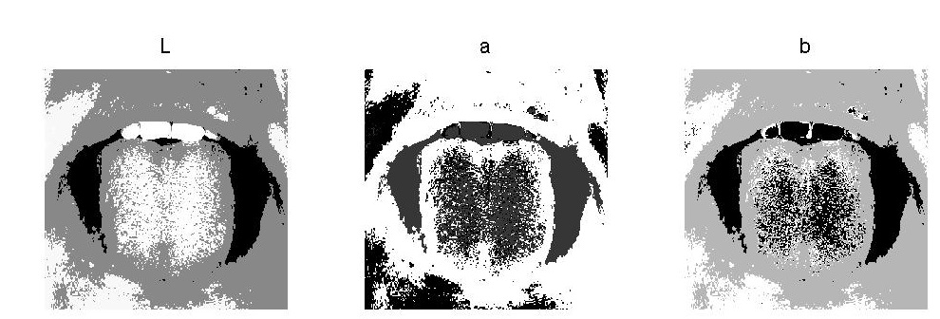
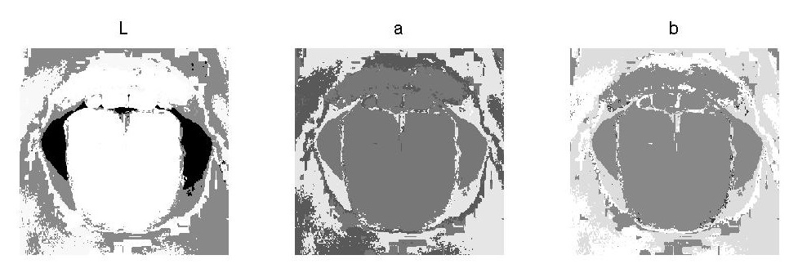
Why CEM?
channels before CEM
channels after CEM

Slide 5
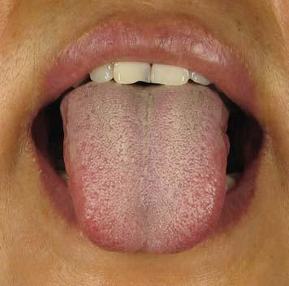
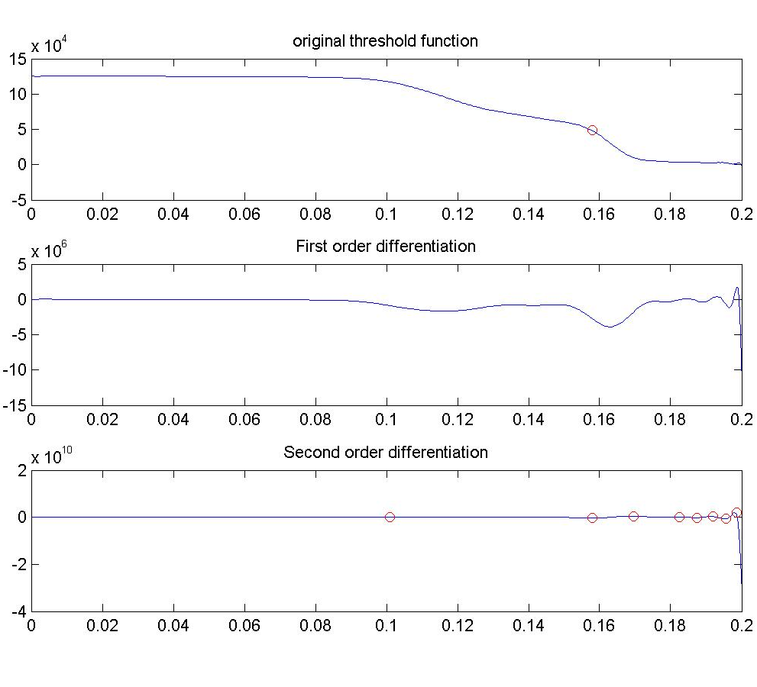



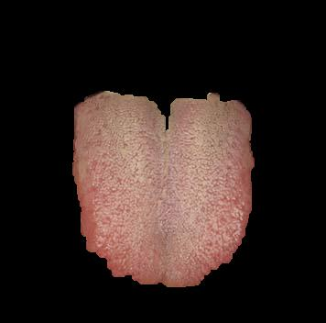
Procedure
Selected areas after CEM
Original
hue threshold control function
valid pixels in L*a*b* color space
After open operation
Final

Slide 6
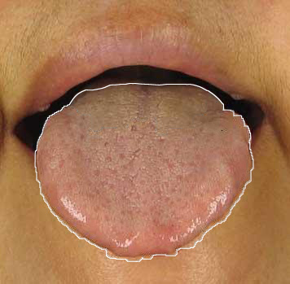
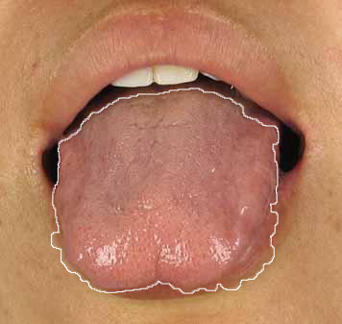
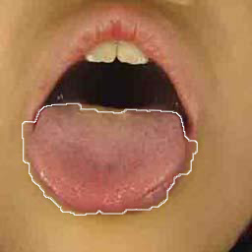
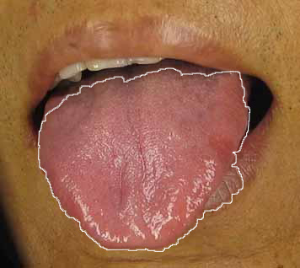
More Examples

Slide 7
Comparison with classical method
Algorithm | CEM-L*A*B* | watershed | Original snake | C2G2FSnake
Speed (s) | 0.630 | 1.65 | 4.01 | 11.46
Q (%) | 98.9 | 89.0 | 73.4 | 98.4

