Slide 1
An Improved Acquaintance Immunization Strategy for Complex Network

Slide 2
Classic immunization strategies
Random immunization strategy immunizes a node randomly
High immunization threshold
Target immunization strategy immunizes a node with most neighbor nodes
Based on global information
Acquaintance immunization strategy randomly chooses a node and randomly immunizes one of its neighbor nodes
Blindness

Slide 3
Problem
Existing improvements:
a) existing improvements to acquaintance immunization(common neighbor, threaded-tree, double immunization) – static and whole scale
b) determine local or time-varying importance ranking -- fail to deploy the benefits of acquaintance immunization strategy
Need an improved strategy which is more adaptive to most network topology and achieve a better balance between cost and effectiveness.

Slide 4
Our method
combining these two benefits
acquaintance immunization (strong adaptability using little information)
local and time-varying information (accuracy during immunization)
Using NSI (Network structure index )

Slide 5
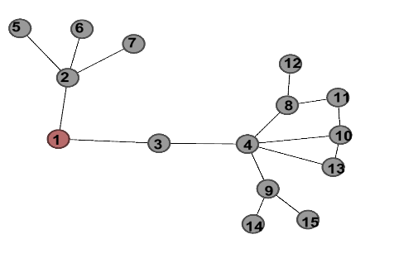
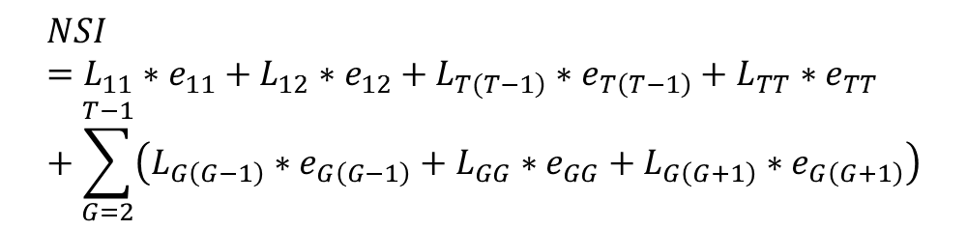
NSI
Mark layer number
Find value and connectivity
Calculate NSI to reflect value of nodes
$$NSI={L_{11}∗e}_{11}+{L_{12}∗e}_{12}+L_{\left.T(T−1\right)}∗e_{T\left(T−1\right)}+{L_{TT}∗e}_{TT}+\sum_{G=2}^{T−1}{\left({L_{G\left(G−1\right)}∗e}_{G\left(G−1\right)}+{L_{GG}∗e}_{GG}+{L_{G\left(G+1\right)}∗e}_{G\left(G+1\right)}\right)}$$
e is the emphasis parameter, L is the possible damage through connections, T is layers

Slide 6
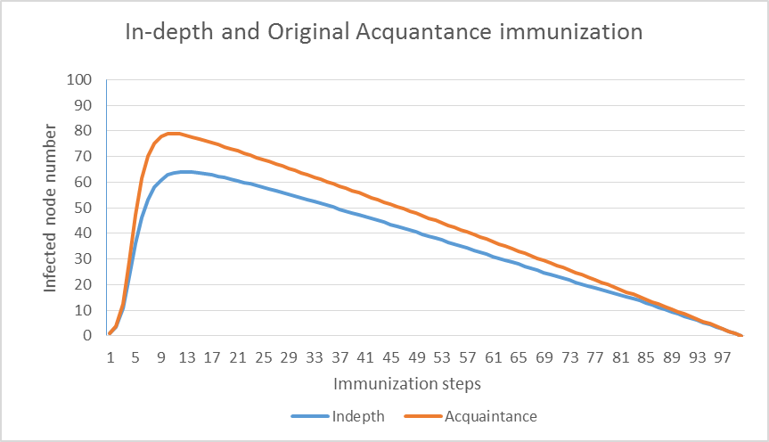
Simulation result
protecting 14.895 more nodes
Rising slope decreased
The average number of 200 times simulations of infected node number during 100 immunization steps using In-depth Acquaintance Immunization strategy and Original one.

Slide 7
More simulations
GDTANG network with various connection possibilities
Random graph with various scale
Random graph with various wiring probabilities
WS-Small World Model with various replacement probability
Scale free model with various exponent of the degree distribution

Slide 8
Conclusion
In GDTang and Scale-free network models, its performance is only second to target immunization
In most random graph, it is even the best strategy
In WS-Small World Model, it is not effective when network is highly regular
in general, it has obvious advantage over the original acquaintance strategy (protects more nodes and control spread rate)

