Slide 1
#4812 Carotid Artery Localization and Lesion Classification on 3D-MERGE MRI using Neural Network and Object Tracking methods
Li Chen†, Huilin Zhao†, Niranjan Balu, Xihai Zhao, Rui Li, Jianrong Xu, Thomas S Hatsukami, Jenq-Neng Hwang, Chun Yuan
Vascular Imaging Lab
† Equal contribution

Slide 2
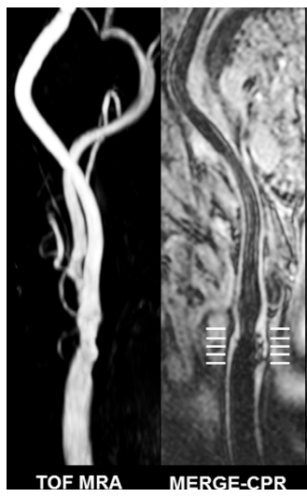
Screening for carotid atherosclerotic lesion
Carotid atherosclerotic lesions are high risk factors for cardiovascular events
  Identifiable through MR vessel wall imaging
  Screening on high risk population is important
Fast scan and automated diagnosis are critical for large-scale screening
  Established: 3D-MERGE [1], a fast (2-minute) imaging sequence
  The missing part: develop a fully automated artery localization and lesion classification model for carotid lesion with high accuracy
  LATTE (lesion assessment through tracklet evaluation)
atherosclerotic lesion shown in TOF and 3D-MERGE
[1] N. Balu, et.al, Magn. Reson. Med, 2011. DOI:10.1002/mrm.22642
Image from Y. Cai, et.al, EJR, 2017

Slide 3
Dataset for development
Institutional Review Board approved and informed consent obtained
Subjects
  296 subjects enrolled as part of the Carotid Atherosclerosis Risk Evaluation II (CARE-II) study [1]
  Poor image quality or part of artery out of the field of view were excluded (73 subjects)
  183, 19, 21 subjects were used as training, validation and testing sets.
  An average of 95.9±41.1 slices were used per subject.
Imaging
  3D MERGE scanned on a 3.0T Philips MR scanner
  Using bilateral carotid phased array coils
  Imaging parameters: TR/TE=10.35/4.87, acquired resolution =0.7mm isotropic (interpolated to 0.35mm isotropic).
[1] Zhao X, et.al, Journal of the American Heart Association, 2017

Slide 4
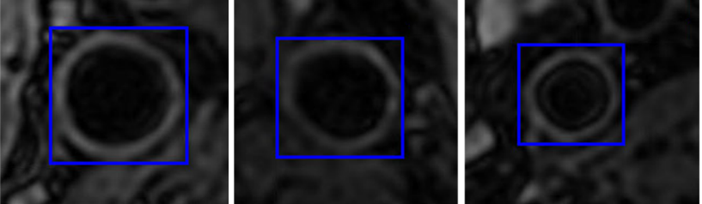
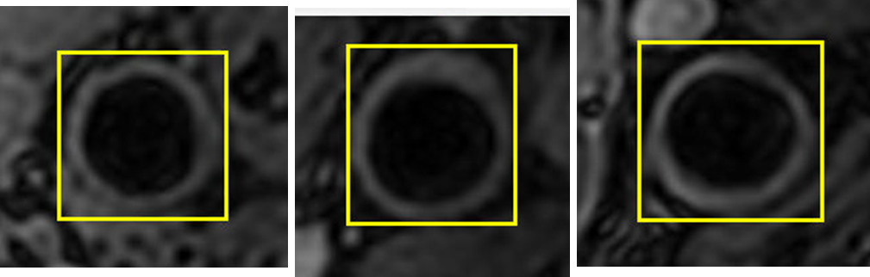
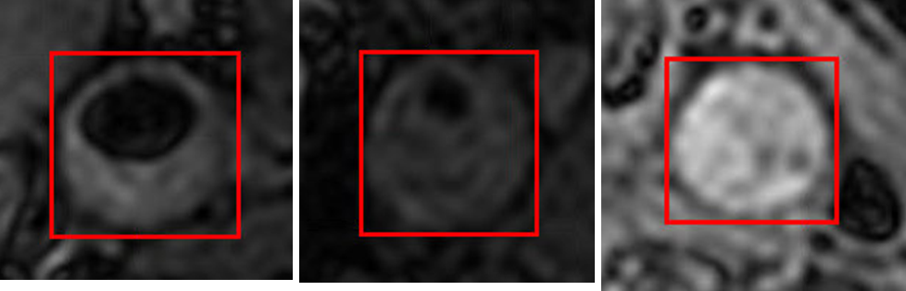
Human labeling
An experienced radiologist labeled bounding boxes for lesions with 3 categories
Category | Definition | Example image slices
Normal artery | AHA type I-II lesion, normal or near-normal wall thickness
Early lesion | AHA type III lesion, diffuse intimal thickening or small eccentric plaque with no calcification
Advanced lesion | AHA type IV-VIII lesions, plaque lesion with wall thickening ≥1.5mm or occlusion

Slide 5
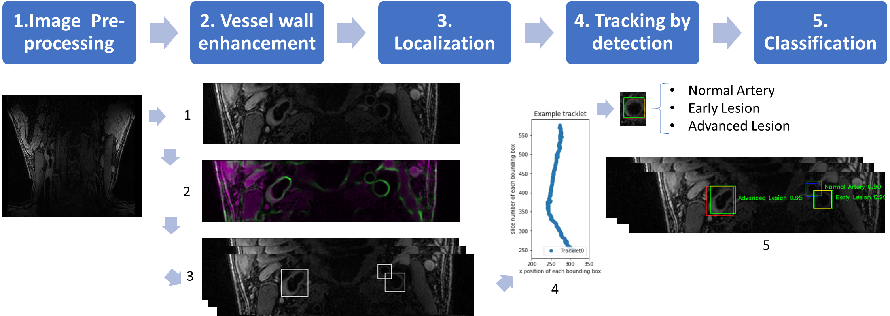
Procedure of LATTE (lesion assessment through tracklet evaluation)
Workflow for fully automated artery localization and lesion classification model in this study
[1] Chen L, et. al. MRM 2018.

Slide 6
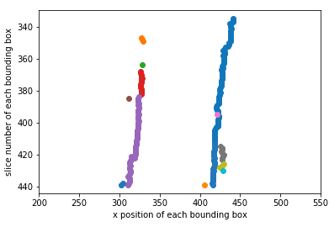
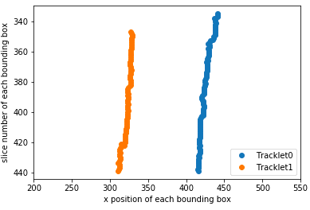
Technical innovations: Artery detection, tracking, segmentation and classification
Detect arteries in each slice using retrained Yolo V2 [1]
Track arteries: Correct discontinuous traces using neighboring information
  Remove noise detections
  Interpolate missing detections
Segment vessel wall in each slice and classify into one of the three lesion classes
Missing detections
Tracklet refinement
Noise detections
[1] J. Redmon, et.al, CVPR, 2017

Slide 7
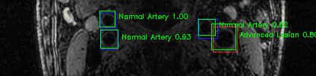
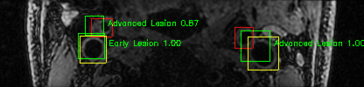
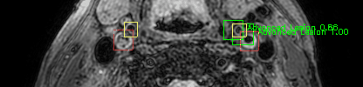
Localization and Classification Results
Localization:
  Avg Intersection over union (IOU): 0.790
  Box hit/miss/false-detect #: 5163/92/11
Three category classification
  Accuracy: 0.792
  Weighted Kappa: 0.80 (0.80-0.81)
Advanced lesion classification
  Accuracy: 0.911
  Sensitivity: 0.912
  Precision: 0.904
  Specificity 0.909
Examples of predictions on test sets
Green boxes: predictions with class and confidence
Blue/Yellow/Red boxes: ground truth for normal artery, early lesion, and advanced lesion

Slide 8
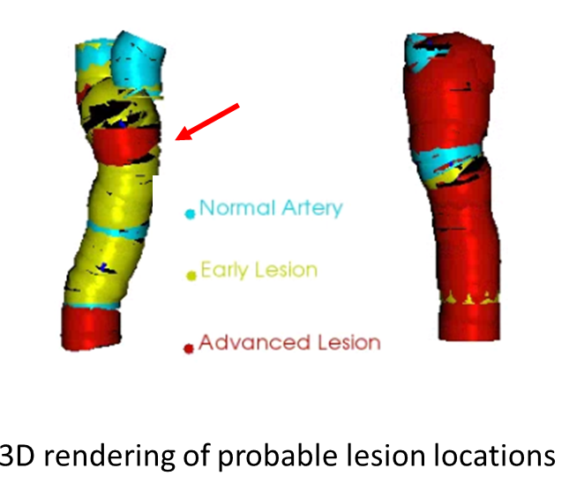
3D Visualization tool for manual confirmation
3D visualization of vessel wall with lesions painted in different colors
Axial/coronal/sagittal/Cross-sectional view for lesions by clicking on a specific location
Radiologists only need to focus on segments with high risk lesions to relieve review burden

Slide 9
Discussion and Conclusion
Latte model was shown to accurately identify artery locations and detect lesion types with a high performance
  With innovative technical pieces:
    Convolutional Neural Network for localization and classification
    Object Tracking methods
Clinical applications
  High-risk lesion screening among a large population
  Training inexperienced radiologists in small centers
  Identify lesion location in other vascular beds, such as intracranial arteries
The ability for further improvement through accumulation of data

Slide 10
Acknowledgements
This research is supported by grants from Natural Science Foundation of China (81271536, 61271132 and 81361120402), National Institute of Health (R01-HL103609) and Philips Healthcare.
We gratefully acknowledge CARE-II investigators and support of NVIDIA Corporation for donating the Titan Xp GPU.
The presenter has no financial interests or relationships to disclose with regard to the subject matter of this presentation.
For more questions, please contact Li Chen (cluw@uw.edu)

