Slide 1
3D intracranial artery segmentation using a convolutional autoencoder
IEEE BIBM 2017
Li Chen, Yanjun Xie, Jie Sun, Niranjan Balu,
Mahmud Mossa-basha, Kristi Pimentel,
Thomas Hatsukami, Jenq-Neng Hwang, and Chun Yuan
Vascular Imaging Lab

Slide 2
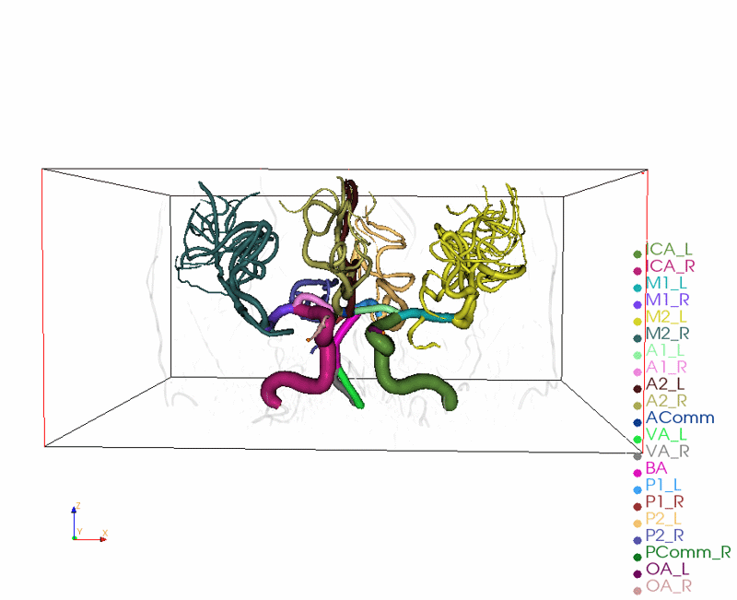
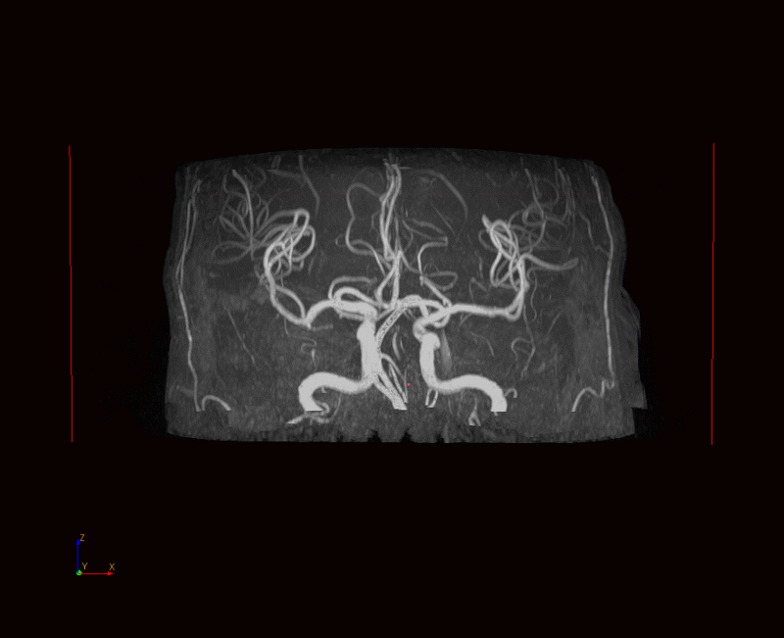
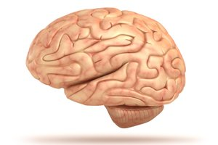
Brain arteries tell your health
3D time-of-flight (TOF)
magnetic resonance angiography (MRA)
Medical Image processing machine learning
Segmentation of intracranial artery regions
Feature extraction from vascular tree
Reconstruction of complete vascular tree
Evaluation of brain health
Brain image from: https://www.livescience.com/29365-human-brain.html
TOF image from Vascular imaging lab, UW
Notes:
A healthy cerebrovascular system that delivers sufficient blood flow to all brain territories is of vital importance for maintaining brain health
3D Time
With this technique, neurological diseases (stroke dementia) revealed to involve significant vascular contribution
To further investigate relation of disease with vascular structure or flow, the analysis on complete vas tree needed
One approach to achieve

Slide 3
3D vessel segmentation methods
Filter based methods
  Frangi filter [1]
  Sato filter [2]
Region growing methods
Thresholding methods
  Slice based: Renyi [3]
  Regional based: Phansalkar [4]
[1] Frangi, et.al. 1998, MICCAI
[2] Sato, et.al. 1998, Medical Image Analysis
[3] Kapur, et.al. 1985, Graphical Models and Image Processing
[4] Phansalkar, et.al. 2011, ICCSP
3
Notes:
heavily depend on human specified vessel descriptor
Not robust to generate a comprehensive cerebrovascular map with consistently high performance

Slide 4
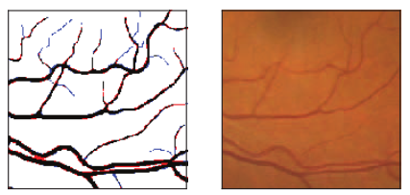
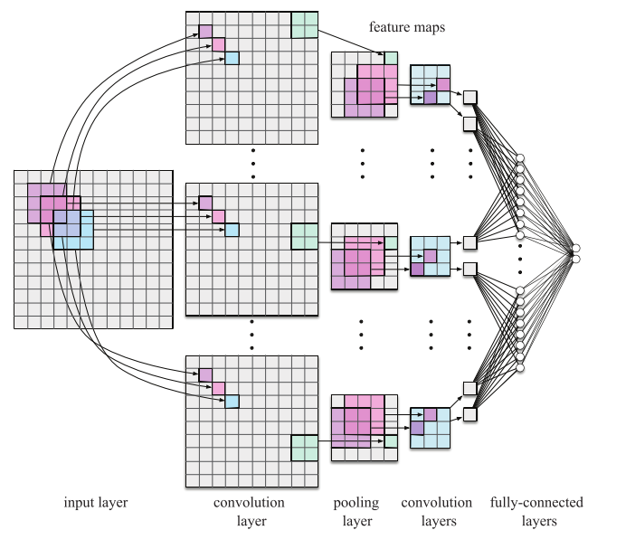
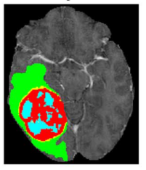
Convolutional neural network (CNN) in medical image segmentation
2D retinal vessel [1]
  Significantly outperform previous algorithms
  Area under ROC curve (AUC) >0.99
3D brain tumor [2]
  First position in Brain Tumor Segmentation Challenge 2013 database (BRATS 2013)
Drawbacks
  Redundancy due to overlapping patches
  Trade-off between localization accuracy and the use of context
Examples of segmentations and network structures
[1] Liskowski, et.al. 2016, IEEE Trans Med Img
[2] Pinto, et.al. 2016, IEEE Trans Med Img
4
Notes:
Alexnet
Patch 27, 33

Slide 5
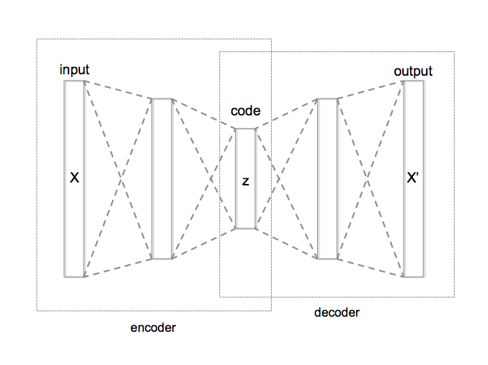
Convolutional autoencoder
Auto-encoder (AE) [1]
  Unsupervised learning of efficient coding
  Same input and output
Denoising auto-encoder (DAE) [2]
  Partially corrupted input
  Train to recover the original input
Convolutional autoencoder (CAE)
  Replace fully connected layers by convolutional layers
  Use labeled image as output
  Supervised learning
Auto-encoder structure (from Wikipedia)
[1] Rumelhart, et.al. Parallel Distributed Processing. 1986
[2] Vincent, et.al. ICML 2008
5

Slide 6
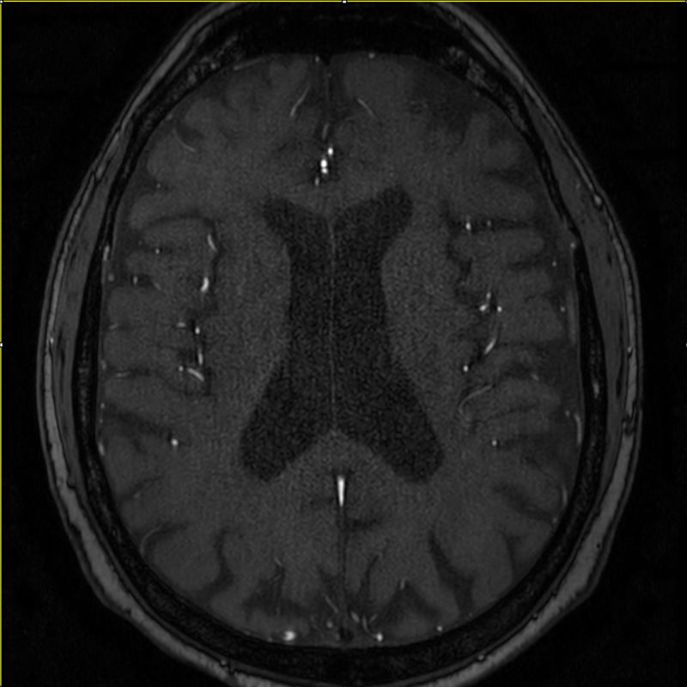
Challenges ahead
TOF MRA is a widely available MRA sequence for diagnosis
However,
  No good labeled images
    No public dataset
    Manual segmentation difficult
  Large dimension of image/network
  Small training dataset
  No arteries in most area
One slice of original 3D TOF MRA image
6

Slide 7
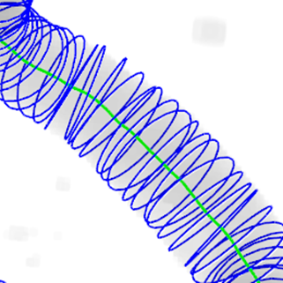
Creating labeled image
49 cases 3D TOF MRA images of brain
  Size: 620*620*243 isotropically re-sliced
  Resolution: 0.297 mm³/voxel
  Training 46 cases, Validation 2 cases, Test 1 case
Labeled by a semi-automated technique: iCafe [1]
  Arteries traced by an active contour model [2] as tubular structures
  Edited by experienced iCafe user
  Validated by experienced neuro-radiologist
Fill inside of tubes as binary labeled images
An example traced artery
[1] Chen, et.al. 2017, Magn Reson Med
[2] Wang, et.al. 2011, Neuroinformatics
7
Notes:
Ensure accuracy in connections, radius, curves and length

Slide 8
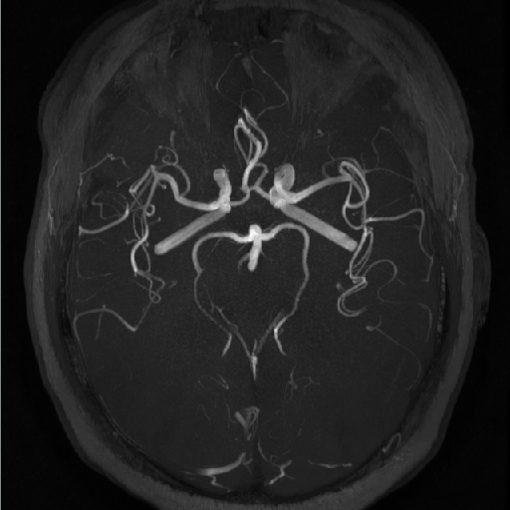
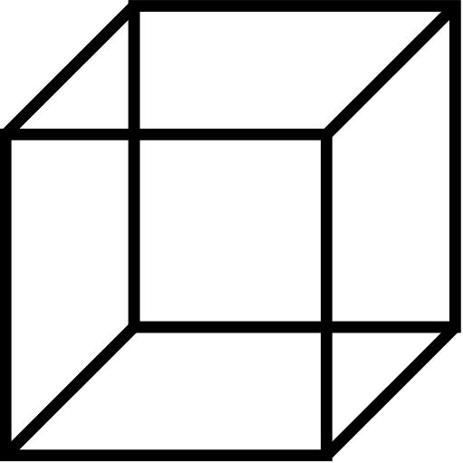
Using patch
Use small 3D patches (cubic of 16)
  Regional similarities of artery structures
  Artery diameter rarely exceeds 16 pixels
  Simpler network structure
  More training samples
  Memory and calculation concern
Location information saved
  Normalized 3D position of center pixel
Different stride size to balance classes
  Small stride extract artery patch
  Large stride extract non-artery patch
1. Small sliding stride to extract artery patches
2. Large sliding stride to extract similar number of non-artery patches
8
Notes:
Problem of large dimension of network and small size of samples
Structure simplified and trainable

Slide 9
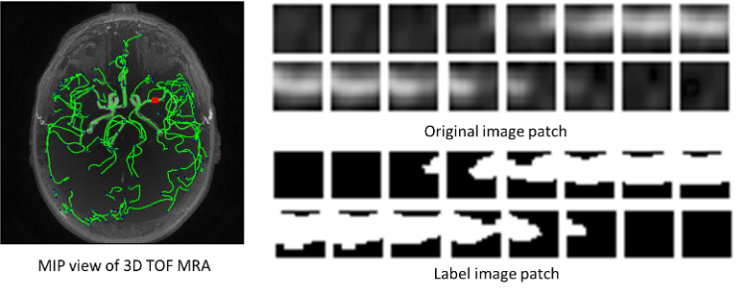
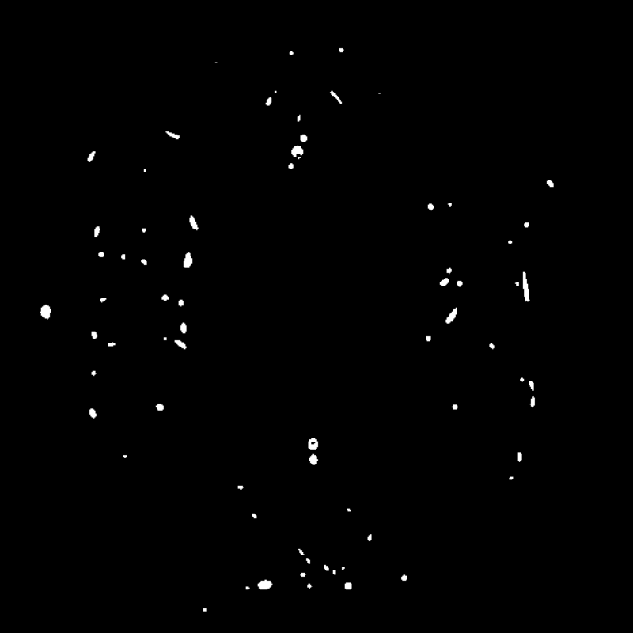
Sample of labeled image
One slice of original 3D TOF MRA image
One slice of labeled 3D image (1 for artery region)
9

Slide 10
Y-net structure
Input image patch
Output image patch
Concatenate
16
16
16
16
16
16
Copy
16
16
16
16
16
16
16
16
16
Convolution: 3*3*3*16
16
Max-Pooling: 2*2*2
Up-Sampling: 2*2*2
Convolution: 3*3*3*32
16
Convolution: 3*3*3*16
16
Concatenate
8
8
8
Copy
8
8
8
8
8
8
8
8
Convolution: 3*3*3*32
8
8
8
Convolution: 3*3*3*32
8
Max-Pooling: 2*2*2
Up-Sampling: 2*2*2
Concatenate: 64+3 kernels
4
4
4
4
4
4
4
Y-net
4
4
Convolution: 3*3*3*64
Convolution: 3*3*3*67
X
4
Encoding path
4
4
4
Decoding path
Y
4
4
Position path
Z
4
4
4
10
Normalized patch position
Notes:
3D CAE with size of 16
By mp us, size reduced to 4 then
Then two copy paths added to combine high res img in encoding (with localization info) and upsampled img in decoding (with conceptual info)

Slide 11

Metrics used for evaluation
Highly unbalanced classes
  Nearly 99.4% voxels are non-artery voxel
Accuracy: (TP+TN)/(TP+FP+FN+TN))
Sensitivity: TP/(TP+FN)
Specificity: TN/(TN+FP)
Precision: TP/(TP+FP)
Dice similarity co-efficient (DSC): 2*TP/(2*TP+FP+FN)
The Area Under an ROC Curve
TN
FN
TP
FP
Red contour: Ground truth
Green contour: Prediction result
11
Notes:
To non-binary methods, choose threshold on validation set with highest dice
Intersect/union area

Slide 12
Binary classification comparison between methods
Models (threshold) | Accuracy | Sensitivity | Specificity | Precision | DSC
CAE (0.38) | 0.99837 | 0.83815 | 0.99913 | 0.81883 | 0.82838
Renyi | 0.99500 | 0.52331 | 0.99724 | 0.47272 | 0.49673
Phansalkar | 0.85897 | 0.92017 | 0.85868 | 0.02992 | 0.05795
Frangi (0.004) | 0.99626 | 0.38955 | 0.99912 | 0.67673 | 0.49447
Sato (0.058) | 0.997099 | 0.566802 | 0.999128 | 0.754003 | 0.647136
Region Growth | 0.99649 | 0.28653 | 0.99983 | 0.89045 | 0.43355
CAE (0.38) no position path | 0.99823 | 0.82208 | 0.99906 | 0.80465 | 0.81327
CAE (0.38) epoch 100/525 | 0.99801 | 0.80282 | 0.99893 | 0.77965 | 0.79107
12
Notes:
Highest dice
Although sensi and spec, include significant amount of noise or missing most artery regions
No position worse
1/5 epoch better than most methods

Slide 13
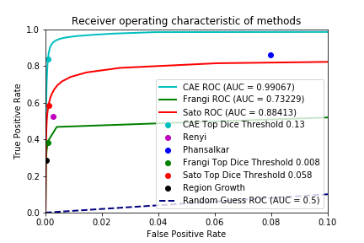
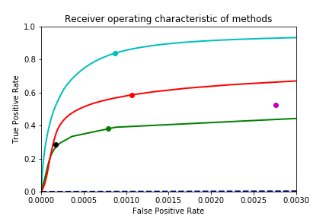
ROC curve of methods
False positive range from 0-0.003
13

Slide 14
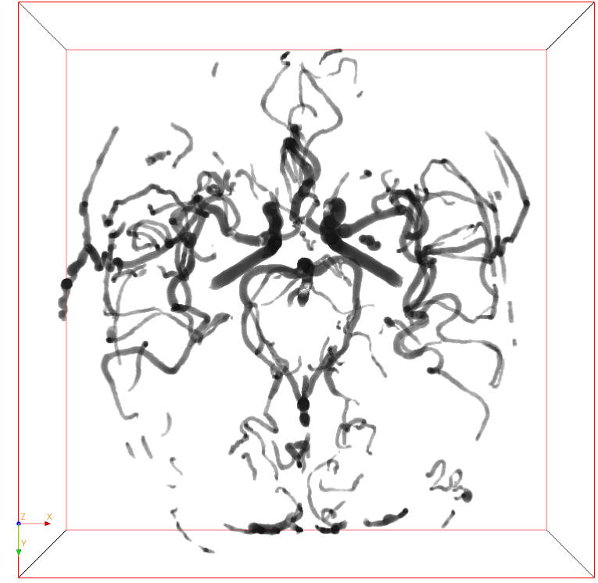
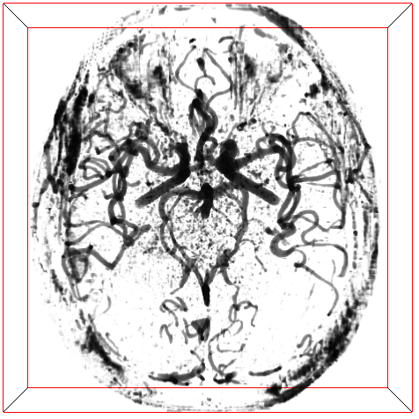
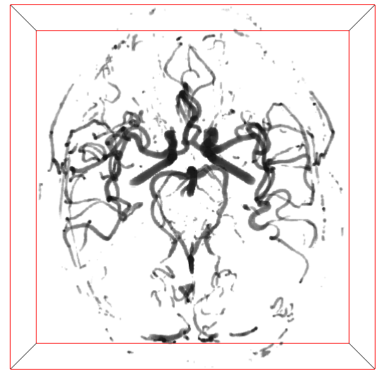
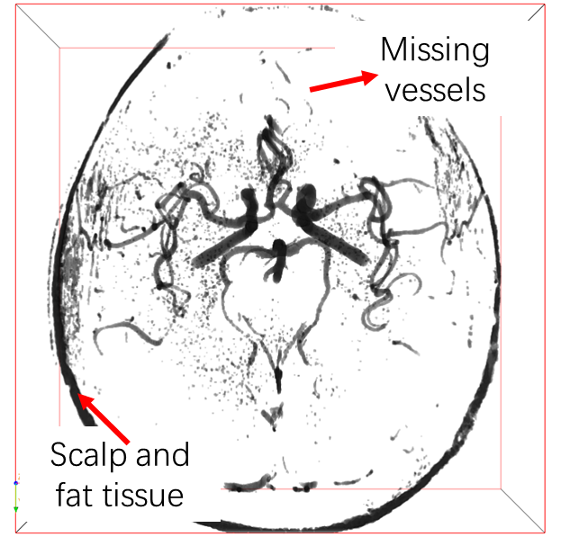
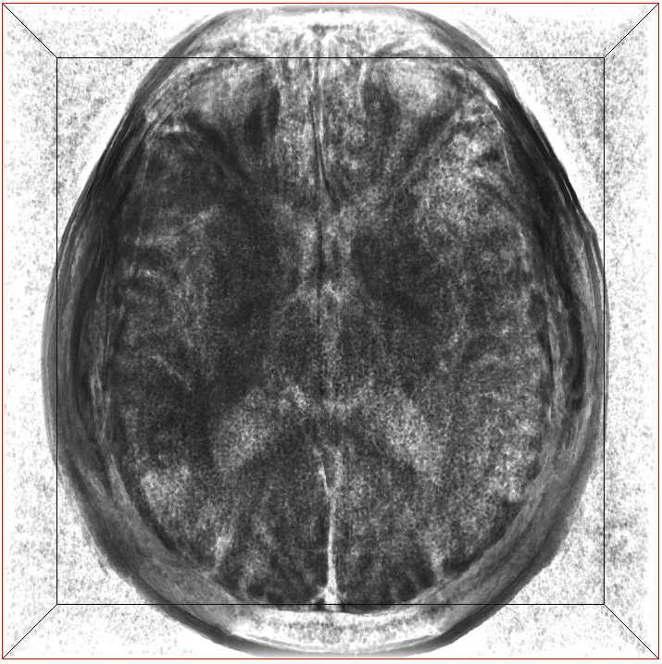
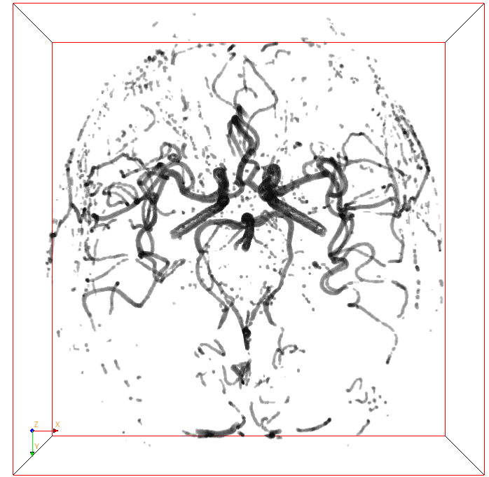
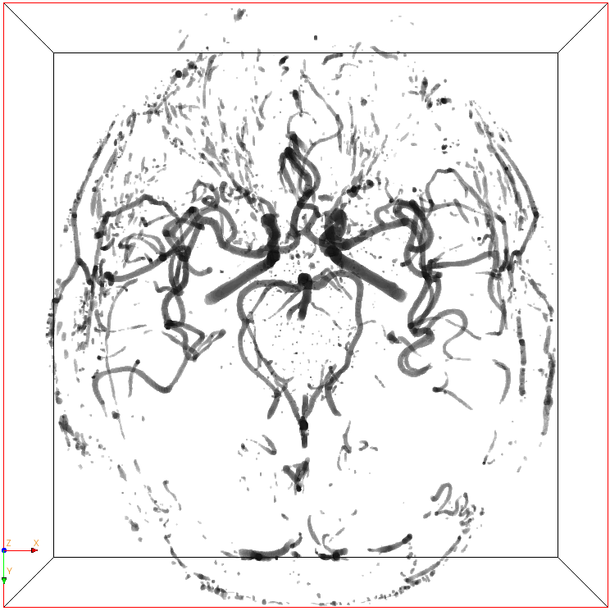
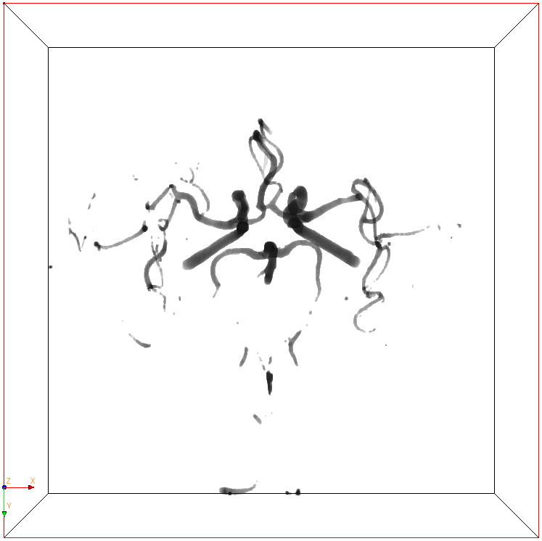
Visualization between methods
(a): Labeled image as ground truth
(b): Probability image predicted from CAE
(c): Binary image after thresholding (b)
(d): Phansalkar thresholded image
(e): Renyi Entropy thresholded image
(f): Frangi filtered (optimal thresholded)
(g): Sato filtered (optimal thresholded)
(h): Region growth image
(a) Ground truth
(b) CAE probability
(c) CAE thresholded
(d) Renyi
(e) Phansalkar
(f) Frangi
(g) Sato
(h) Region growth
14

Slide 15
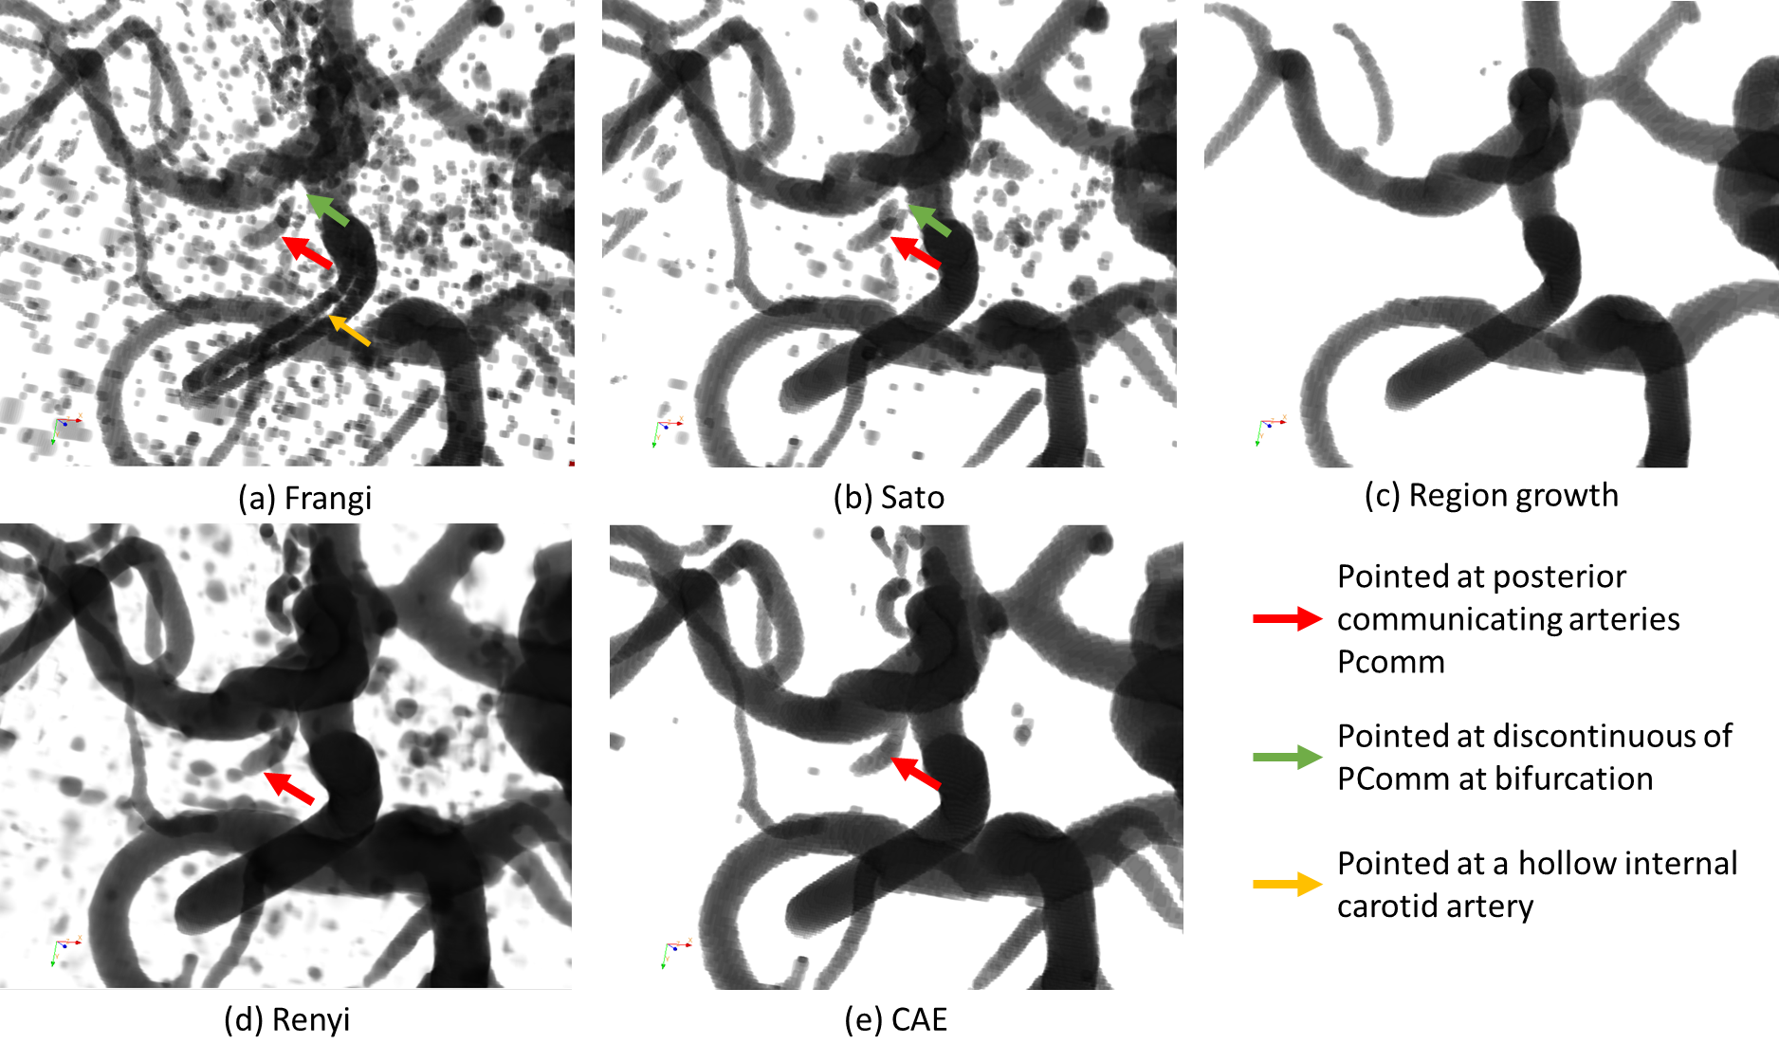
Visualization of Pcomm artery between methods
Noise, and discontinuity near bifurcation in Frangi (a) and Sato (b) filtered images
Pcomm misssing by region growth method (c)
Noise, and broken Pcomm in Renyi Entropy thresholded image (d)
CAE filtered Pcomm (e)
Phansalkar image is too noisy to see Pcomm
Pcomm: Posterior communicating artery, an important artery between anterior and posterior cerebral circulation
15

Slide 16
Highlights
Application:
  Convolutional neural network for intracranial artery segmentation
  Available because of the high quality labeled images
Network structure:
  Y-net CAE with position for efficient and effective training
Training methods:
  Patch based
  Balanced samples
  3D network operations
16

Slide 17
Acknowledgement
This research is supported by grants from
  National Institutes of Health (R01 NS083503, R01 NS092207, and R01 HL103609)
  American Heart Association (17MCPRP33671077)
  Philips healthcare
We are grateful to the support of NVIDIA Corporation with donation of the Titan X GPU.
17

Slide 18
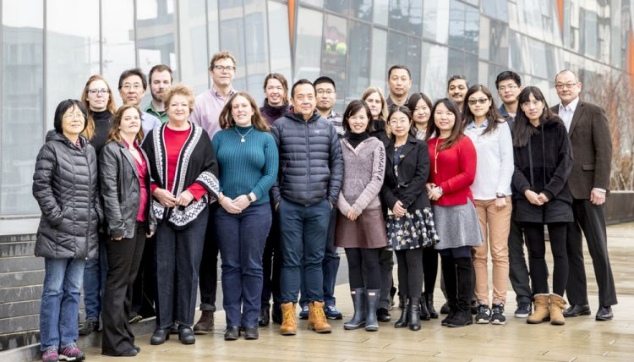
Thanks!
Q&A
Vascular Imaging Lab
University of Washington
18

Slide 19
FAQ
More details about iCafe traced labeled images?
What about the performance of CAE using different thresholds?
What is the difference between Y-net and the popular U-net?
More details about training process?
How to prove patch position improves the performance?
How do other intracranial segmentation papers validate results?
3D view of segmented results?
Technical details about other traditional methods? Why fail?
19

Slide 20
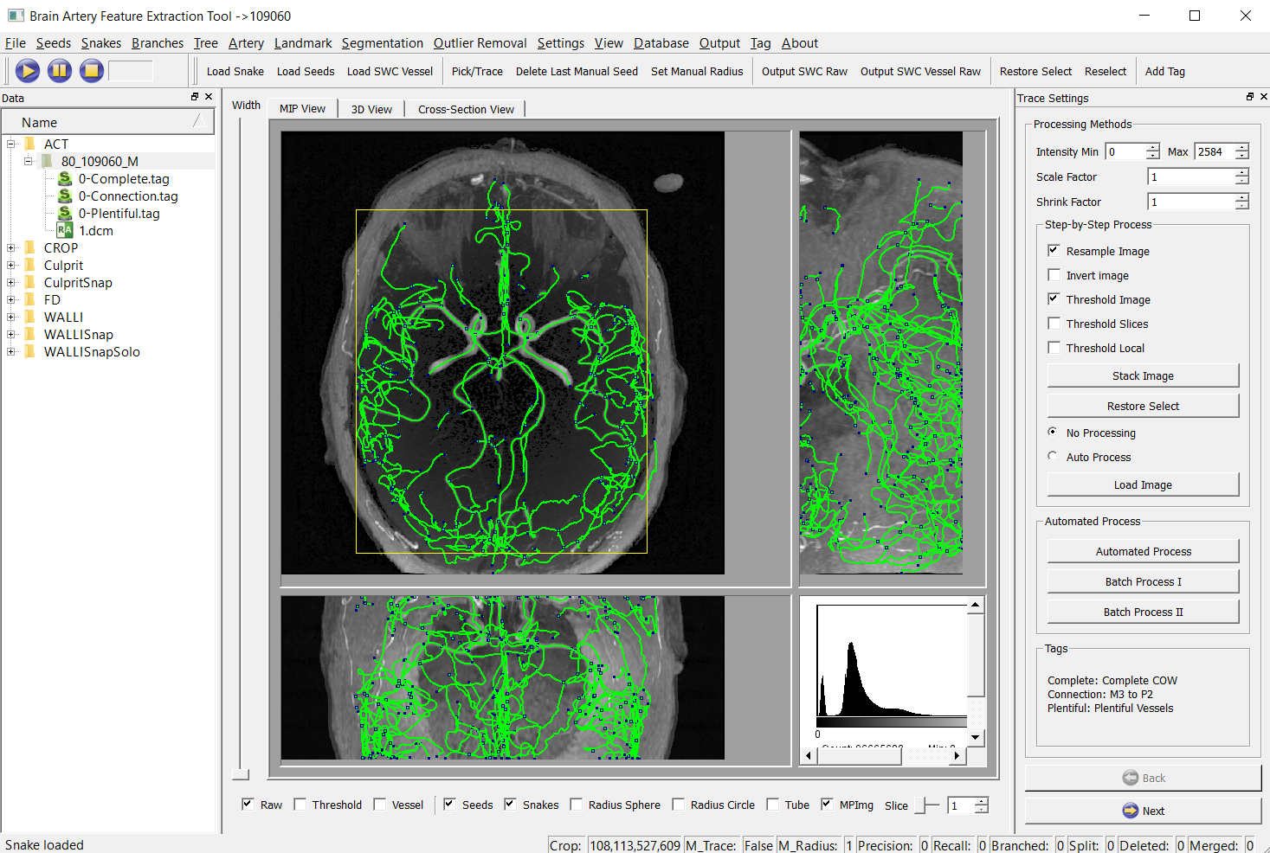
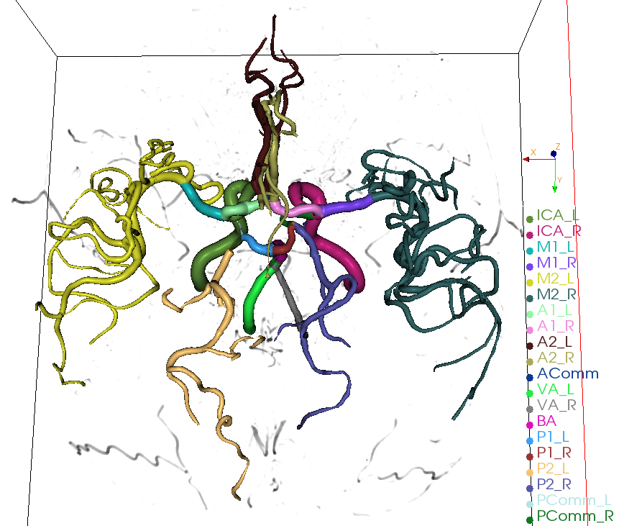
User interface and vessel display in iCafe
User interface of iCafe
3D rendered vascular tree in iCafe
20
Notes:
C++ windows

Slide 21

Labeled image
Validation methods | Validation purposes | Validation results
Position of bifurcation | Correct trace connections | Sensitivity 94% Precision 85%
Position of stenosis | Correct radius estimation | Sensitivity 85% Precision 85%
Length of middle cerebral artery (M1 segment) | Correct traces and curves | intra-class correlation coefficient 0.97
ID | Type | X | Y | Z | Radius | Parent-ID
469 | 0 | 400.479 | 301.581 | 217.787 | 10.905 | 468
470 | 0 | 402.612 | 303.518 | 216.803 | 10.9271 | 469
471 | 0 | 404.97 | 305.395 | 216.476 | 10.9408 | 470
472 | 0 | 407.223 | 307.378 | 215.963 | 10.8209 | 471
473 | 0 | 409.583 | 309.141 | 215.193 | 10.7421 | 472
Three validations for traces
Display of an example traced artery and its data format
21
Notes:
sensitivity of the human rater as (89+7)/(89+19+7)=83%, the PPV as (89+7)/(89+10)=97%.

Slide 22
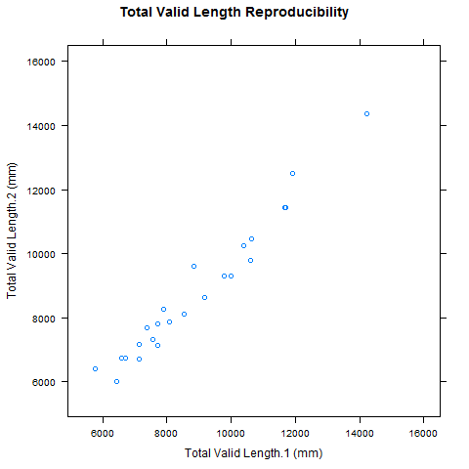
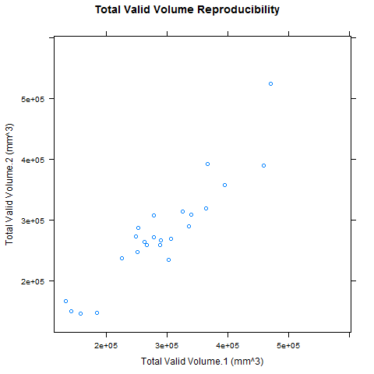
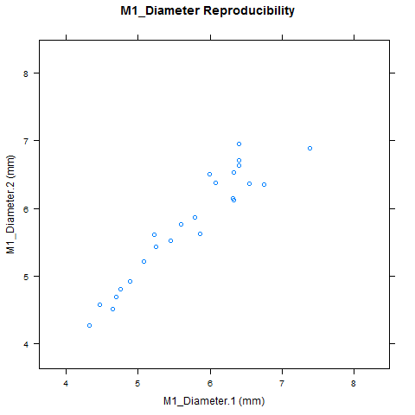
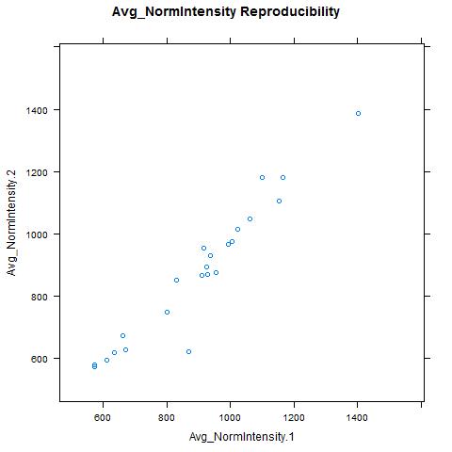
Some reproducibility test results
Length
ICC: 0.980 CV:0.036
Volume
ICC:0.925 CV:0.086
M1 Radius
ICC:0.948 CV:0.03
Normalized intensity
ICC:0.974 CV:0.077
22

Slide 23
Binary classification comparison between methods
Models (threshold) | Accuracy | Sensitivity | Specificity | Precision | DSC
CAE (0.38) | 0.99837 | 0.83815 | 0.99913 | 0.81883 | 0.82838
CAE (0.38) no position path | 0.99823 | 0.82208 | 0.99906 | 0.80465 | 0.81327
CAE (0.38) epoch 100 | 0.99801 | 0.80282 | 0.99893 | 0.77965 | 0.79107
Renyi | 0.99500 | 0.52331 | 0.99724 | 0.47272 | 0.49673
Phansalkar | 0.85897 | 0.92017 | 0.85868 | 0.02992 | 0.05795
CAE (0.15) | 0.99726 | 0.92235 | 0.99761 | 0.64560 | 0.75955
Frangi (0.004) | 0.99626 | 0.38955 | 0.99912 | 0.67673 | 0.49447
CAE (0.051) | 0.99710 | 0.56680 | 0.99913 | 0.75400 | 0.64714
Sato | 0.997099 | 0.566802 | 0.999128 | 0.754003 | 0.647136
Region Growth | 0.99649 | 0.28653 | 0.99983 | 0.89045 | 0.43355
Active Contour | 0.99770 | 0.67583 | 0.99921 | 0.80217 | 0.73360
23

Slide 24
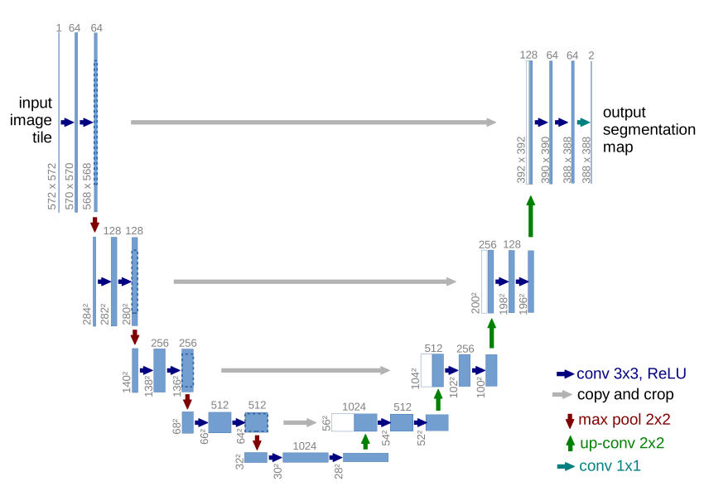
U-net structure
2D segmentation for neural structure and cell
Whole image as input and output
Deeper neural network, slower in training

Slide 25
Training process
No augmentation
Adam Optimizer
Xavier initialization
Activation function: rectified linear unit (ReLU)
Stride in first step: 20
Training time: 745 minutes (525 epochs)
Parameter number: 208,734
25

Slide 26
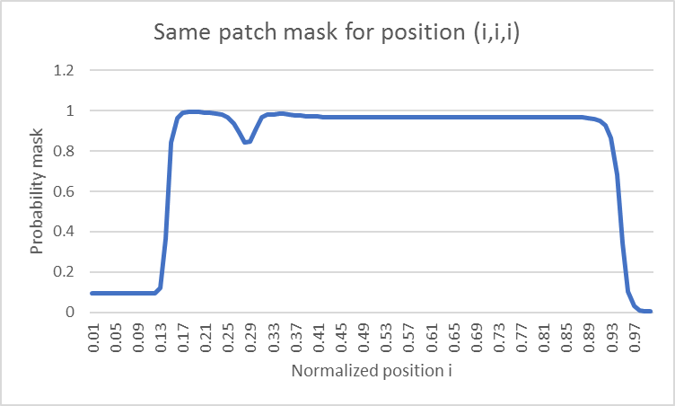
Effective of position path
 | Dice Without | Dice With position
Test 1 | 0.825282798 | 0.826452
Test 2 | 0.825359562 | 0.826573
Test 3 | 0.825361962 | 0.828378
Average | 0.825334774 | 0.827134
Standard deviation | 4.50285E-05 | 0.001079
T test: 0.044752491

Slide 27
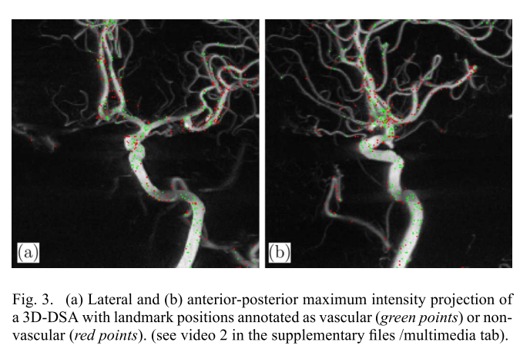
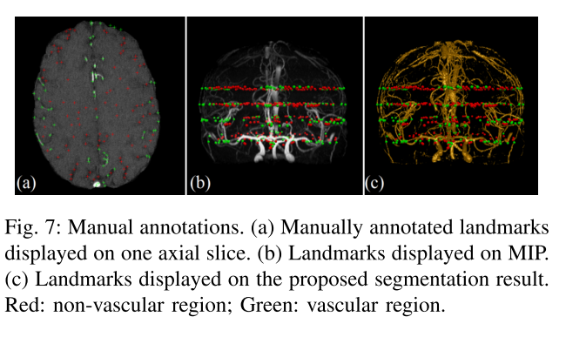
Evaluation using landmarks
Jerman, et.al. 2016. IEEE Tran Med Img
Zhao, et.al. 2017. IEEE Tran Med Img
27

Slide 28
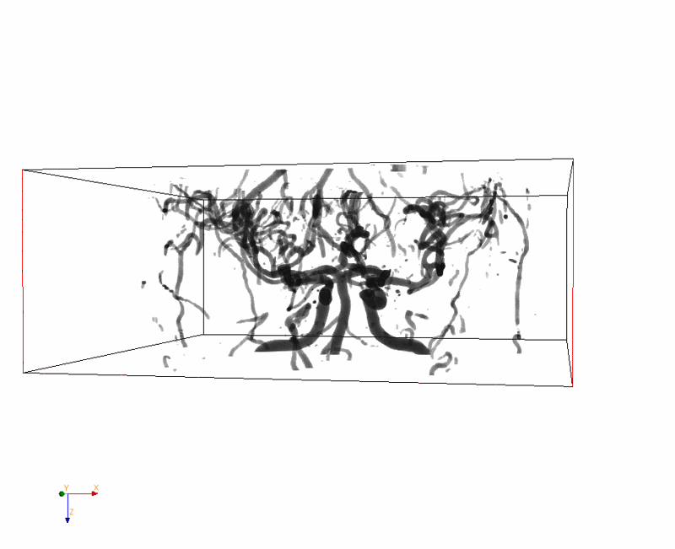
Visualization of segmented image

Slide 29
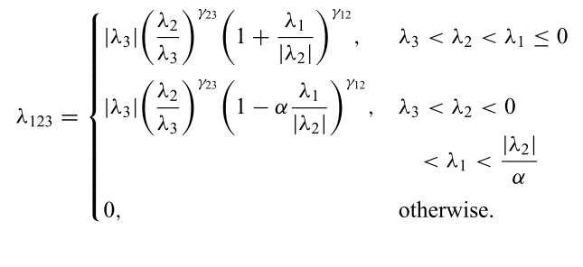
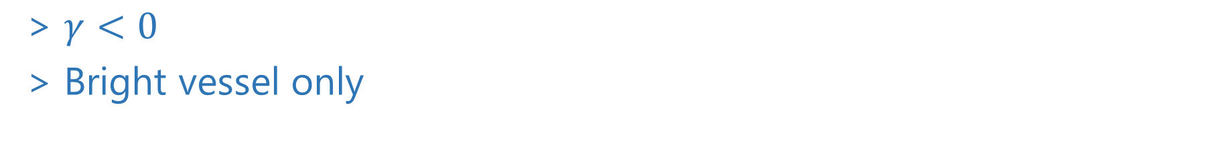
Sato’s filter
$γ<0$
Bright vessel only

Slide 30
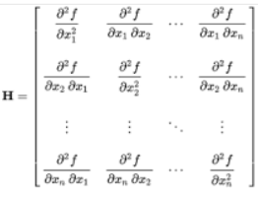

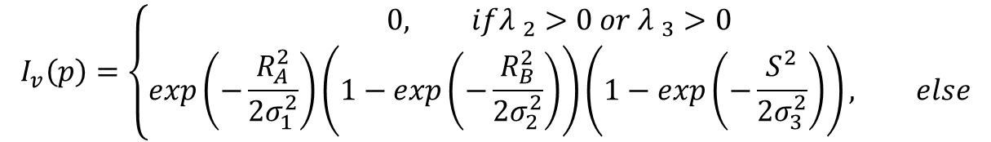
Frangi’s filter
eigenvalues $\left|{λ }_{1}\right|<|{λ }_{2}|$< $|{λ }_{3}|$
second order information (Hessian)
$R_{A}=\left|λ_{1}\right|/\sqrt{\left|λ_{2}\right|\left|λ_{3}\right|}$ differentiates blob-like structure from tube/plate-like structures
$R_{B}=\left|λ_{2}\right|/\left|λ_{3}\right|$ differentiates plate-like structure from tube-like structures
$S=\sqrt{{λ_{1}}^{2}+{λ_{2}}^{2}+{λ_{3}}^{2}}$ for noise suppression from tube-like structures
$$I_{v}\left(p\right)=\left\{\begin{aligned}0, if{λ }_{2}>0 or {λ }_{3}>0 \\ &exp\left(−\frac{R_{A}^{2}}{2σ_{1}^{2}}\right)\left(1−exp\left(−\frac{R_{B}^{2}}{2σ_{2}^{2}}\right)\right)\left(1−exp\left(−\frac{S^{2}}{2σ_{3}^{2}}\right)\right), else\end{aligned}\right.$$
Vesselness
scale factors σ1,σ2,σ3

Slide 31
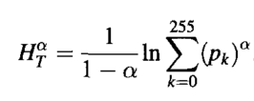
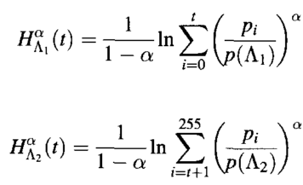

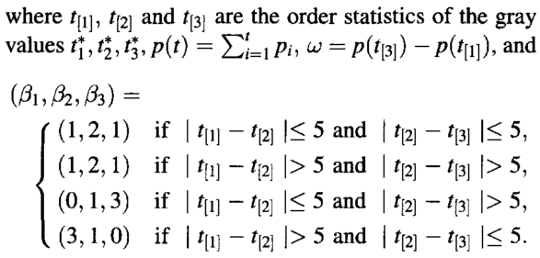
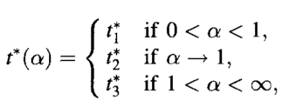
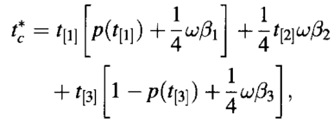
Renyi Entropy
Renyi's entropies for object and
background distributions
Optimal threshold
Notes:
t2 is the same as the optimal threshold value found using the maximum entropy sum method and when a > 1, the gray value t3 is the same as the optimal threshold value obtained by using the entropic correlation method

Slide 32
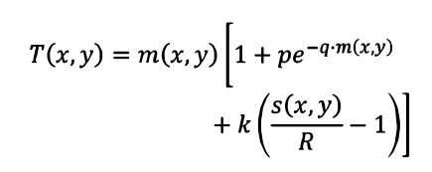
Phansalkar
Segmentation of cell nuclei
Improvement to Sauvola when mean and standard deviation are both low
T(x,y) local threshold
k = 0.25, R = 0.5, p = 2 and q = 10
m(x,y), s(x,y): local mean and standard deviation

Slide 33
iCafe publication
Li Chen, Niranjan Balu, Gandor Canton, Jie Sun, Kristi Pimentel, Thomas Hatsukami, Jenq-Neng Hwang, and Chun Yuan, “Development of a Quantitative Intracranial Vascular Features Extraction Tool on 3D MRA Using Semi-automated Open-Curve Active Contour Vessel Tracing.” Magnetic Resonance in Medicine, 2017.
https://rad.washington.edu/research/research-groups/vascular-imaging-laboratory/
33

